Slide 1
Brief Overview Timeline of African-American History
Unit 7 The Civil Rights Movement

Slide 2
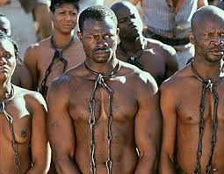
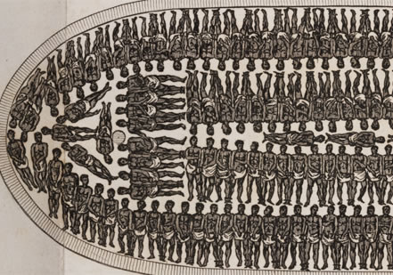
1600s Start of Slavery First African slaves brought to the Americas for tobacco plantations in Southern Colonies & sugar plantations in the Caribbean
The Middle Passage 15 million Africans transported Estimated 2+ million died en route | Amistad Horror & Resistance

Slide 3
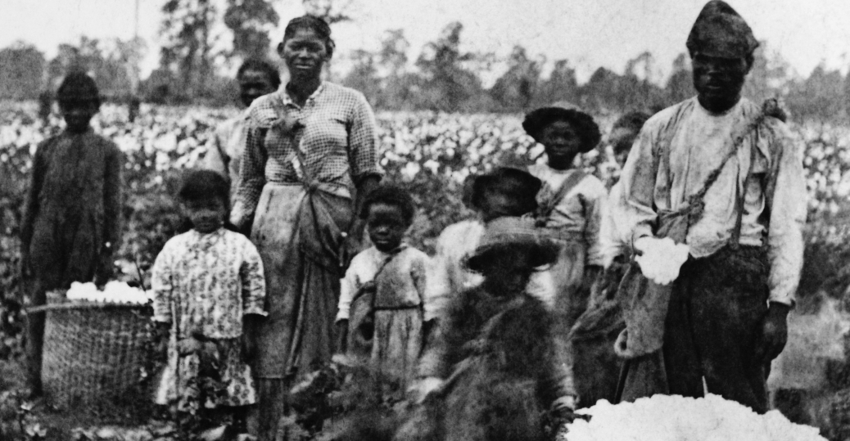
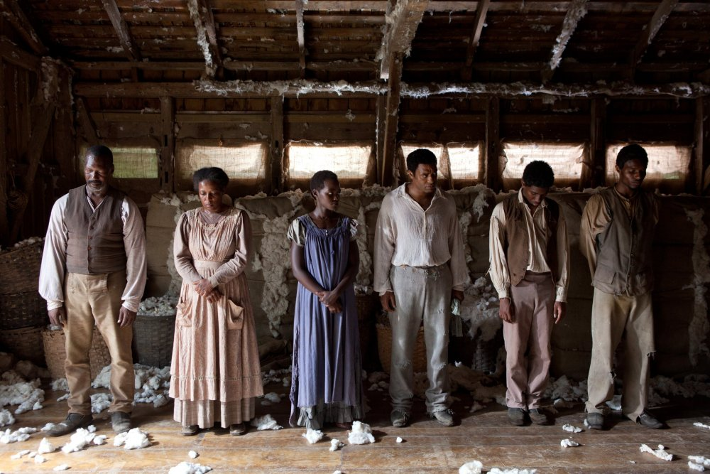
1793 Cotton Gin & Expansion of Slavery at Heart of USA
In 1800s Cotton expands slavery in the USA (700,000 to 1.5 million slaves)

Slide 4
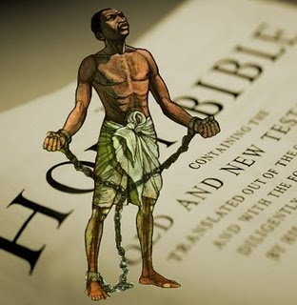
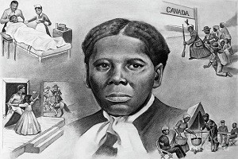
1800s Resistance to Slavery
Slave Revolts Underground Railroad Family & Culture
Nat Turner Harriet Tubman Christianity

Slide 5
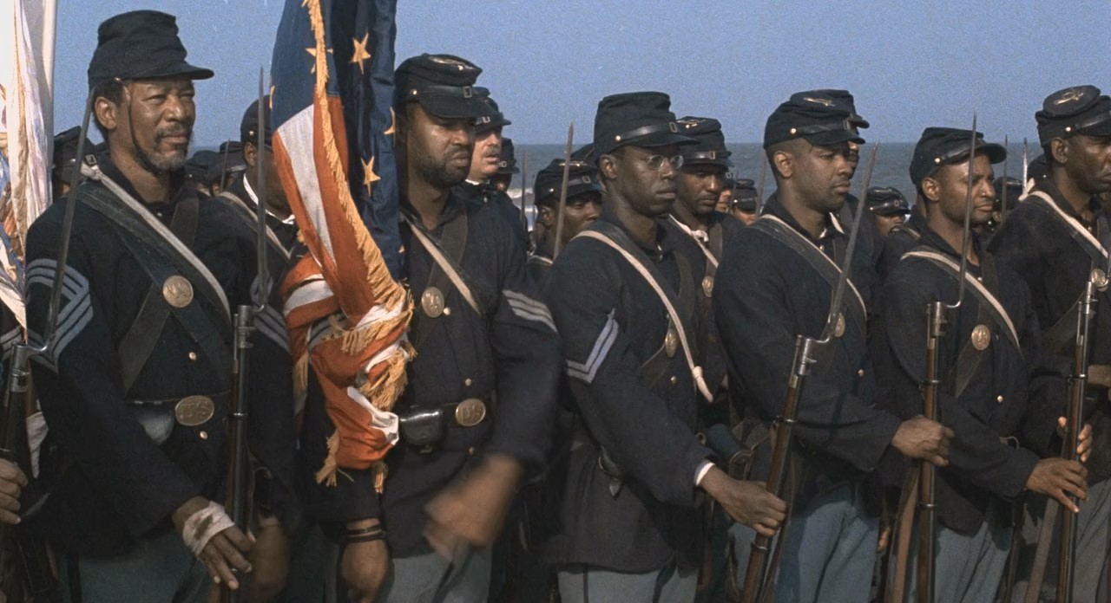
1861-65 USA Civil War
Glory 54th Massachusetts

Slide 6
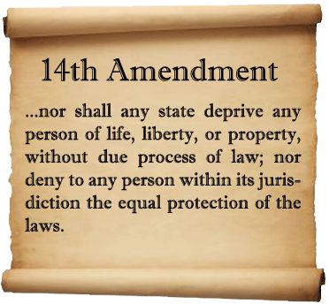
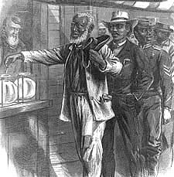
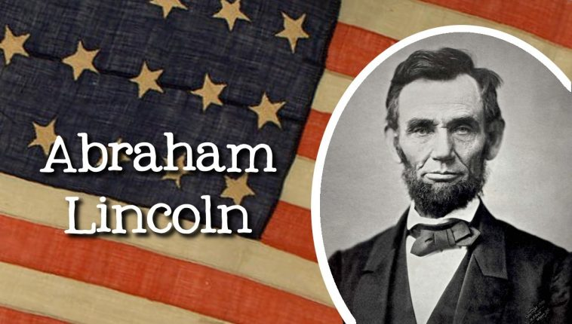
Amendments 13 14 15
13th Amendment 14th Amendment 15th Amendment
Abolish Slavery Equal Protection Right to Vote

Slide 7
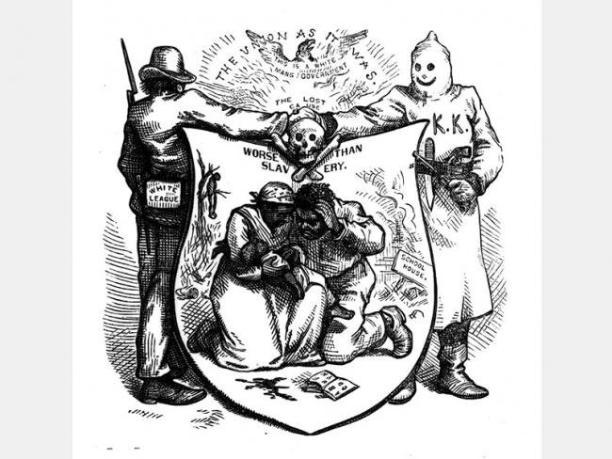
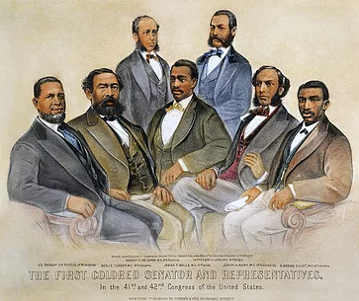
Reconstruction 3 Phases
Phase 1 1860s Phase 2 1870s Phase 3 1880s
“Black Codes” “Radical Republicans” “KKK & Terrorism
“Slavery Part 2” “Democracy Works!” “Democracy Denied”

Slide 8
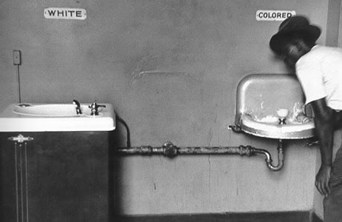
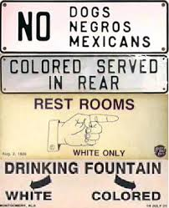
1896 Plessy vs. Ferguson Birth of Segregation & Jim Crow USA
US Supreme Court rules states may SEGREGATE (SEPARATE) everything in their states for African-Americans and whites if they are “separate but equal”. Of course, they were SEPARATE but not EQUAL.

Slide 9
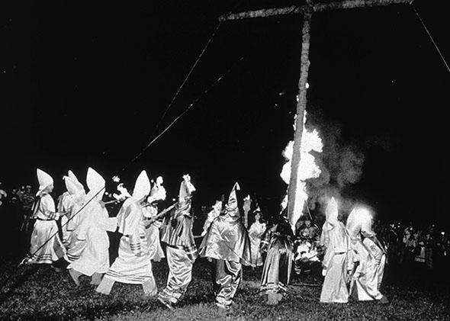
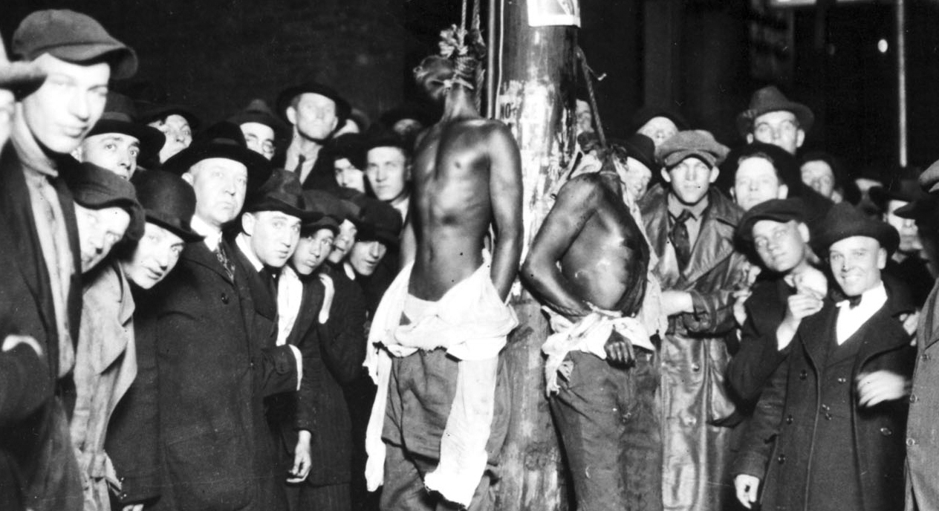
1896-1954: Expansion of Jim Crow Laws, Rise of KKK and Lynching

