Slide 1
Chief Joseph
By kendra

Slide 2
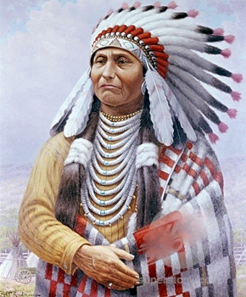
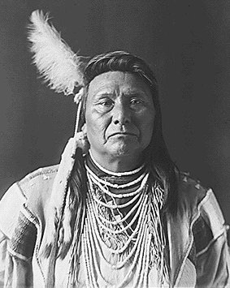
General Info - Chief Joseph
Born in 1840
Wallowa Valley, Oregon Territory
His father - Joseph the elder
Nez Perce
Chief looking glass & White Bird
Notes:
Joseph the Elder's relationship with the whites had been unprecedented. He'd been one of the early Nez Perce leaders to convert to Christianity, and his influence had gone a long way toward establishing peace with his white neighbors.
In 1855, he forged a new treaty that created a new reservation for the Nez Perce.
But that peace was fragile. After gold was discovered in the Nez Perce territory, white prospectors began to stream onto their lands.
The relationship was soon upended when the United States government took back millions of acres it had promised to Joseph the Elder and his people.

Slide 3
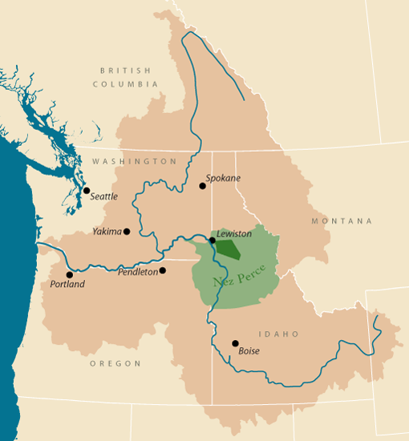
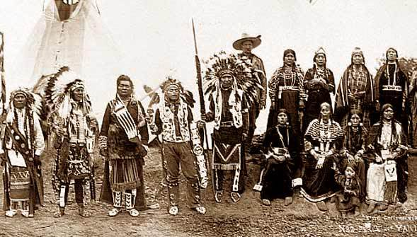
General Info - Nez Perce Tribe
Lived in the Pacific Northwest region of the United States
Present day Washington, Oregon, Montana & Idaho
1 of 5 federally recognized tribes in the state
Language: Niimiipuutímt
Sahaptian language
Notes:
Nez Perce language, or Niimiipuutímt, is a Sahaptian language related to the several dialects of Sahaptin.

Slide 4
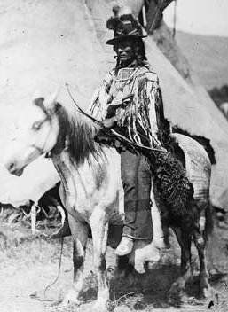
Problem
US gov took back millions of acres of land
Chiefs Looking Glass & White Bird
Resettlement plan
Warriors from White Bird’s band attacked & killed several white settlers
Notes:
But that peace was fragile. After gold was discovered in the Nez Perce territory, white prospectors began to stream onto their lands. The relationship was soon upended when the United States government took back millions of acres it had promised to Joseph the Elder and his people.
The irate chief denounced his former American friends and destroyed his Bible. More significantly, he refused to sign off on the boundaries of this "new" reservation and leave the Wallowa Valley.
As his father had done before him, Chief Joseph, along with fellow Nez Perce leaders, chiefs Looking Glass and White Bird, balked at the resettlement plan.
As tensions mounted, the three chiefs sensed that violence was imminent. In 1877, recognizing what a war could mean for their people, the chiefs backed down and agreed to the new reservation boundaries.
Just before the move, however, warriors from White Bird's band attacked and killed several white settlers. Chief Joseph understood there would be brutal repercussions and in an effort to avoid defeat, and most likely his own death, he led his people on what is now widely considered one of the most remarkable retreats in military history.

Slide 5
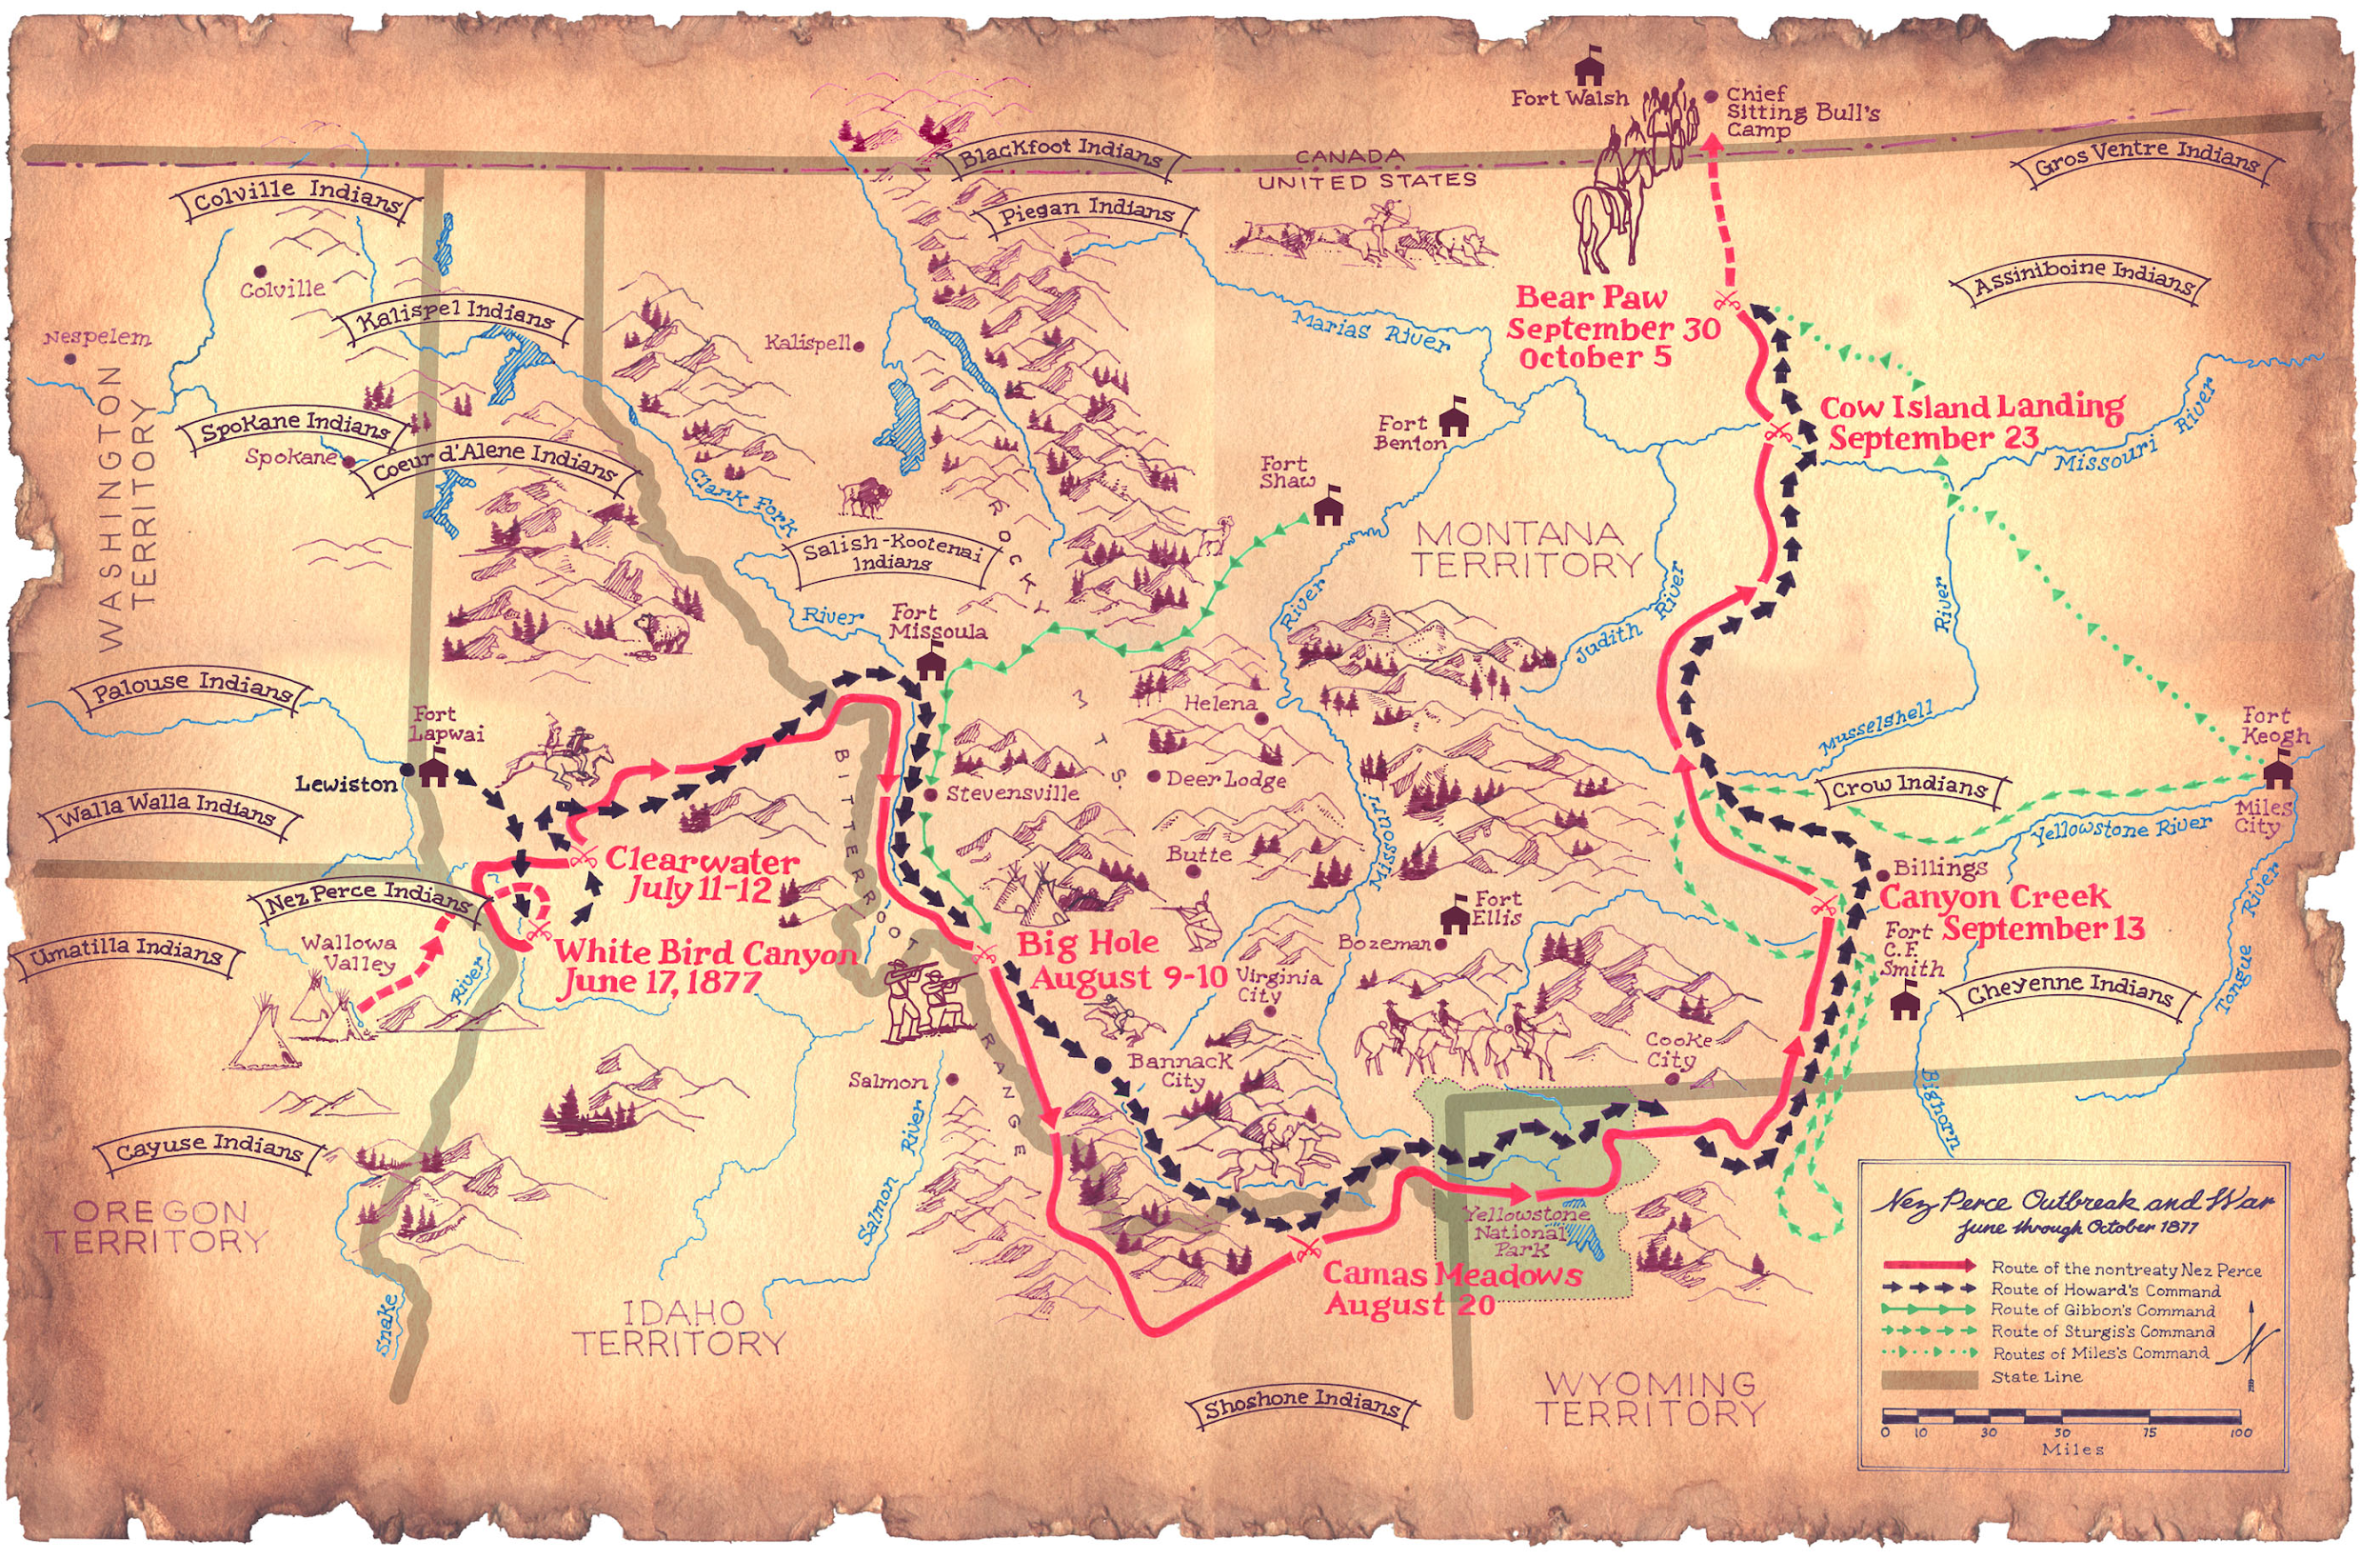
Resistance
700 followers
200 actual warriros
1,400 mile
Canada
Victories against US force
2000<
Fall of 1877
40 miles of Canadian Border
Notes:
Over the course of four long months, Chief Joseph and his 700 followers, a group that included just 200 actual warriors, embarked on a 1,400-mile march toward Canada. The journey included several impressive victories against a U.S. force that numbered more than 2,000 soldiers.
But the retreat took its toll on the group. By the fall of 1877 Chief Joseph and his people were exhausted. They had come within 40 miles of the Canadian border, reaching the Bear Paw Mountains of Montana, but were too beaten and starving to continue to fight.
Having seen his warriors reduced to just 87 fighting men, having weathered the loss of his own brother, Olikut, and having seen many of the women and children near starvation, Chief Joseph surrendered to his enemy, delivering one of the great speeches in American history.

Slide 6
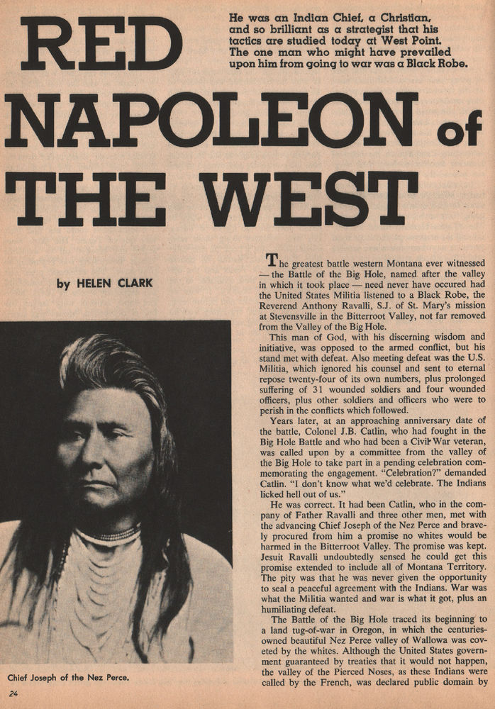
Conclusion
After surrender
Joseph & his ppl - KANSAS (present day oklahoma)
1885
Return to Pacific NorthWest
Even though most died from war or disease
Notes:
Following his surrender, Chief Joseph and his people were escorted, first to Kansas, and then to what is present-day Oklahoma. Joseph spent the next several years pleading his people's case, even meeting with President Rutherford Hayes in 1879.
Finally, in 1885, Joseph and others were allowed to return to the Pacific Northwest, but it was far from a perfect solution. So many of his people had already perished, either from war or disease, and their new home was still miles from their true homeland in the Wallowa Valley.
Chief Joseph did not live to see again the land he'd known as a child and young warrior. He died on September 21, 1904, and was buried in the Colville Indian Cemetery on the Colville Reservation in the state of Washington.

