Slide 1
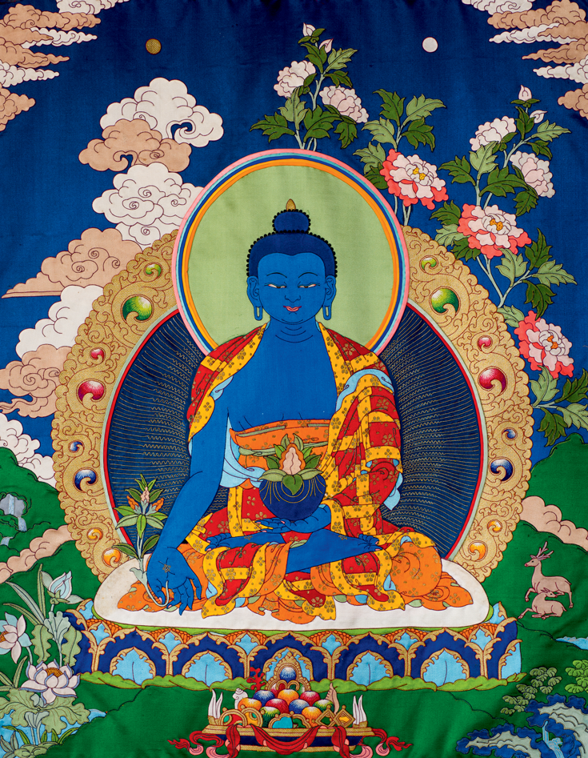
Bhaisajyaguru
By Preston Tang

Slide 2
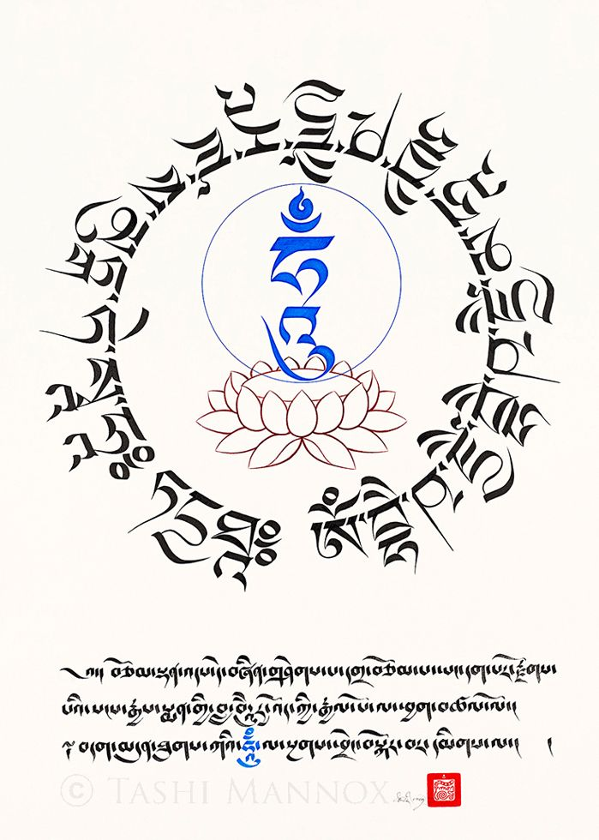
Who is Bhaisajyaguru?
Commonly known as the “Medicine Buddha”
A doctor who cures suffering using the medicine of his teachings.
A bodhisattva who made 12 important vows.

Slide 3
The 12 Vows
Link Here
The Main Ideas
Teach all beings on wisdom to cure suffering
Relieve all beings from materialistic desires
All physically/emotionally sick beings shall be cured

Slide 4
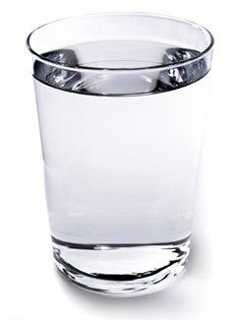
How is Bhaisajyaguru Worshipped?
Tibetan Buddhism
Meditate on Medicine Buddha to decrease physically and mental illness and suffering.
You chant the Medicine Buddha Mantra 108 times over a cup of water, then you drink the water.
Chinese Buddhism
Recite the Medicine Buddha Mantra in a temple to bring good health.

Slide 5
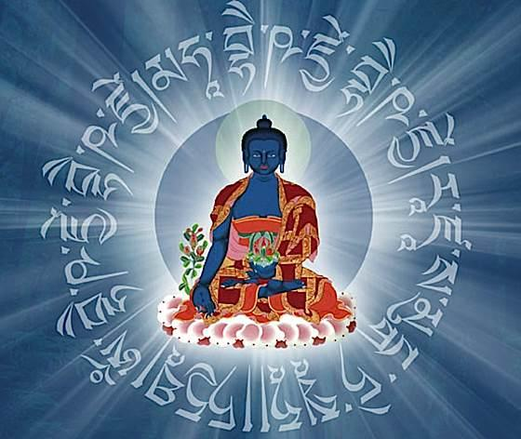
Medicine Buddha Mantra
Short Version of Medicine Buddha Mantra
OM NAMO BHAGAVATE BHAISHAJYE / GURU BAIDURYA / PRABHA RADJAYA / TATHAGATAYA / ARHATE SAMYAKSAM BUDDHAYA / TADYATHA / OM BHAISHAJYE BHAISHAJYE MAHA BHAISHAJYE [BHAISHAJYE ] / RAJA SAMUDGATE SVAHA
“As you recite the mantra, visualize rays of light radiating out in all directions from the syllable at your heart.”

Slide 6
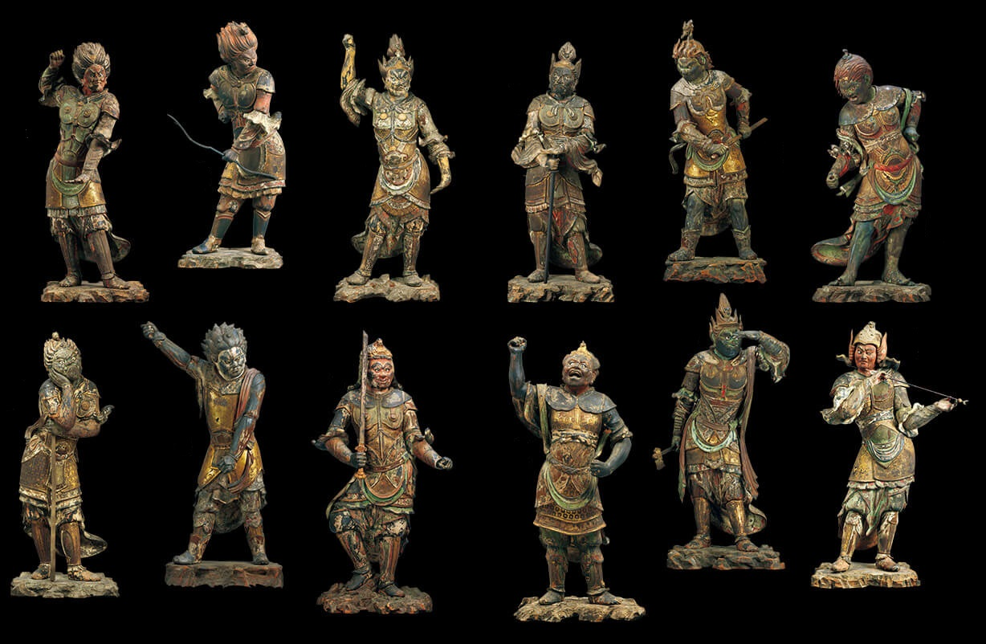
Sutra of the Medicine Buddha
(Bhaiṣajyaguruvaidūryaprabharāja Sūtra)
Composed of 3 Parts
Describing the Twelve Great Vows of the Medicine Buddha
“His extensive merits as well as the various ways he comes to the aid of those beset by sufferings and calamities”
“Sets forth the vows of the twelve Yaksa Generals to benefit sentient beings”
The generals are the protector deities of the Medicine Buddha

Slide 7
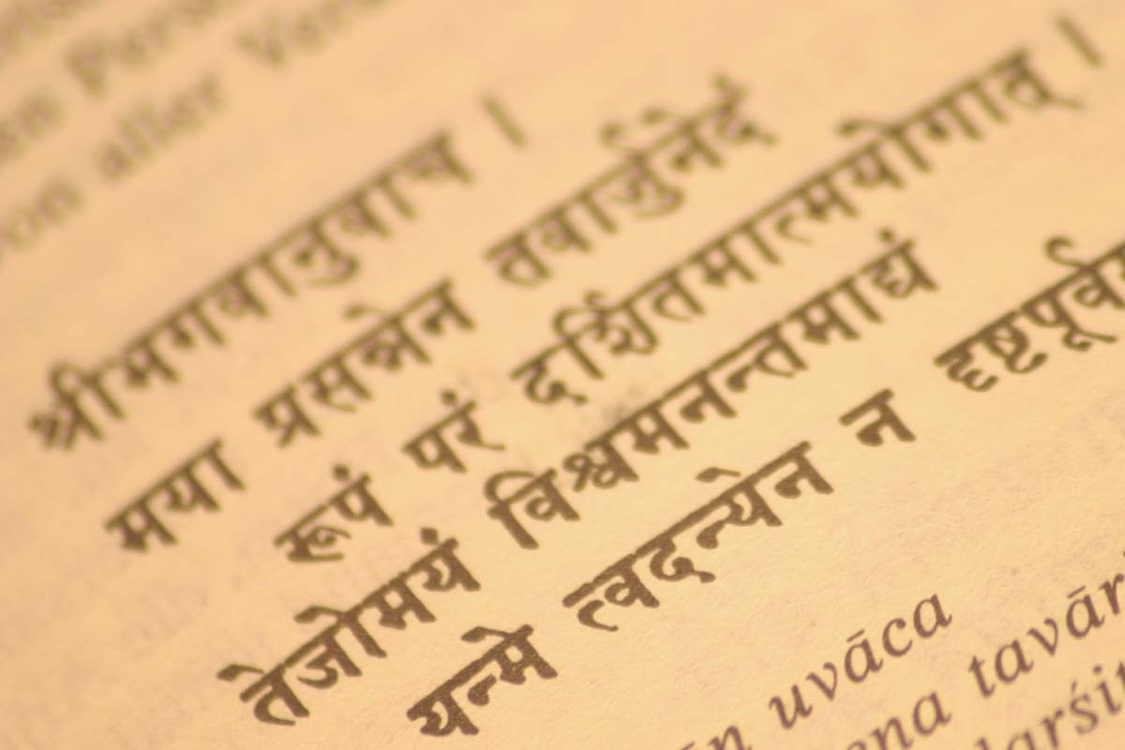
Sanskrit Stuff
Bhaiṣajyaguru is भैषज्यगुरु in Sanskrit, meaning medicine or curative
Is 藥師佛 in Chinese, which basically just means Medicine Buddha
“samadhi”
"Eliminating All the Suffering and Afflictions of Sentient Beings"

Slide 8
Sources
1st Medicine Buddha Picture
Medicine Buddha Mantra Garland
Wisdom Image
Medicine Buddha Mantra (Analysis & Text)
Sutra of the Medicine Buddha
12 Vows of Medicine Buddha from Wikipedia
Image of Cup of Water
Medicine Buddha Mantra: First Doctor
12 Heavenly Generals Image
Sanskrit Image
Sanskrit Translation Website

Slide 9
Thanks for Watching!

