Slide 1
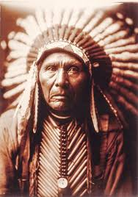
Chief Seattle
Peyton Phillips

Slide 2
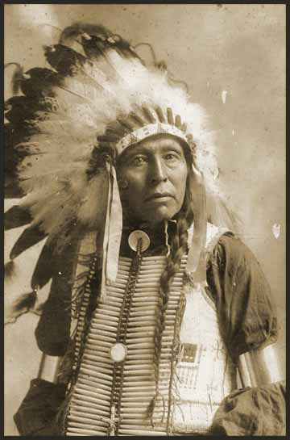
Chief Seattle
Ancestral leader of Suquamish Tribe
Witnessed the transition of his people
Signed 1855 treaty
Created lasting friendships with original settlers
Peaceful Leader
Died in 1866

Slide 3
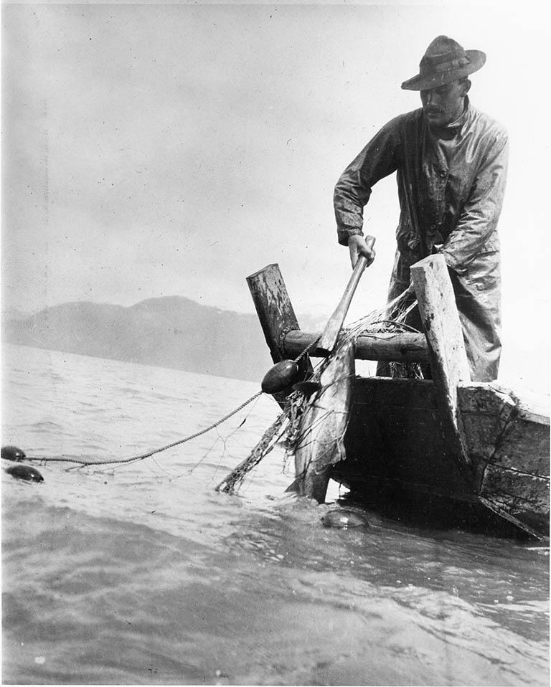
Culture
Pacific Northwest
Harnessed Land and Sea
Fishing
Hunting
Cedar
Dialect of Pacific Northwest Language
Spirituality
2011; Approved Gay Marriage

Slide 4
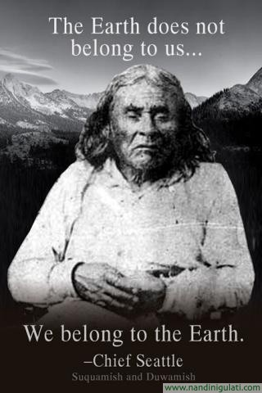
Problem
Fur Traders/Missionaries/Mills
Treaties
Fishing Rights
Community Boundaries
Education

Slide 5
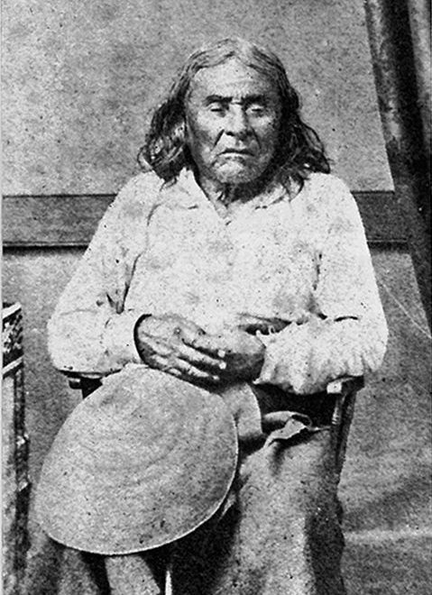
Fighting Back
Speech in 1854
Emotional
Compliance
Condition
Respect Environment
Burial Grounds
Generally Little Resistance
Acceptance and Cooperation

Slide 6
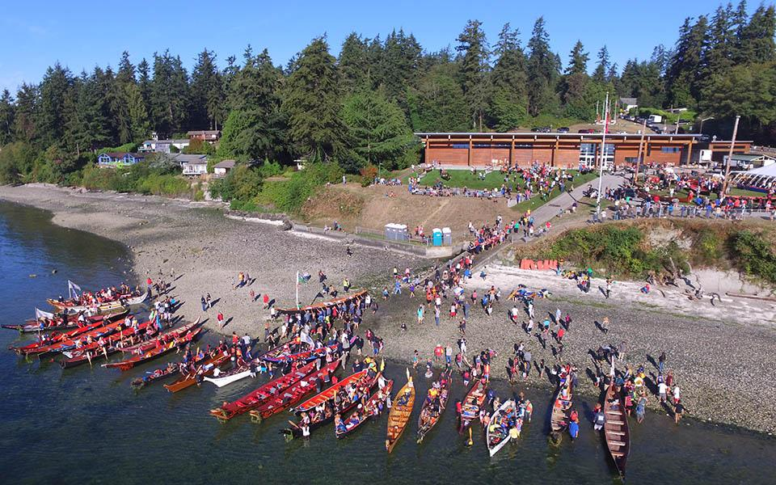
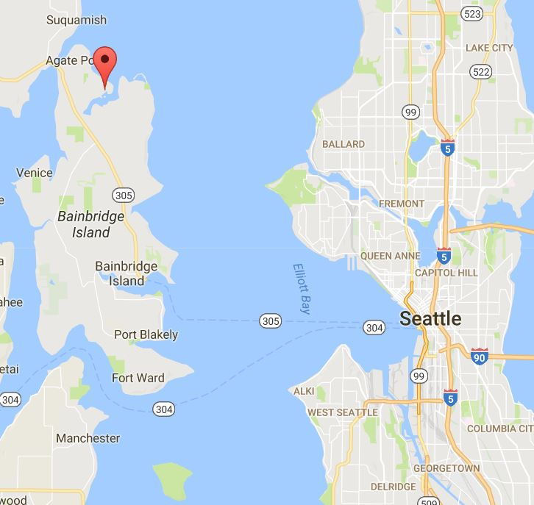
What Happened
Port Madison Reservation
Ultimately same as most NA Tribes
Self-Determination
Centennial Accord

Slide 7
https://suquamish.nsn.us/home/about-us/history-culture/#tab-id-6

