Slide 1
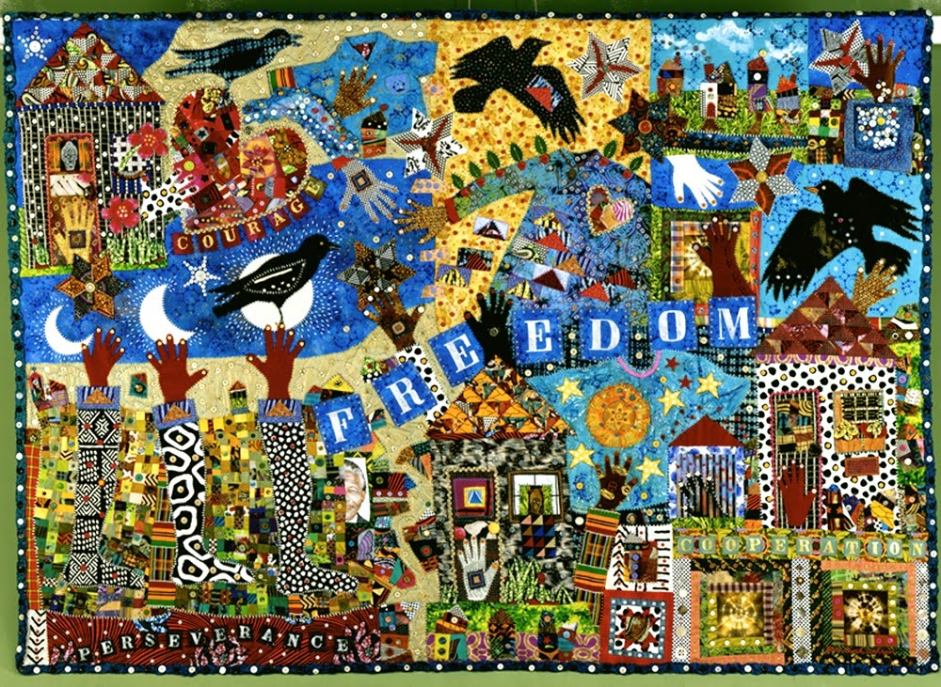
African-American resistance to slavery

Slide 2
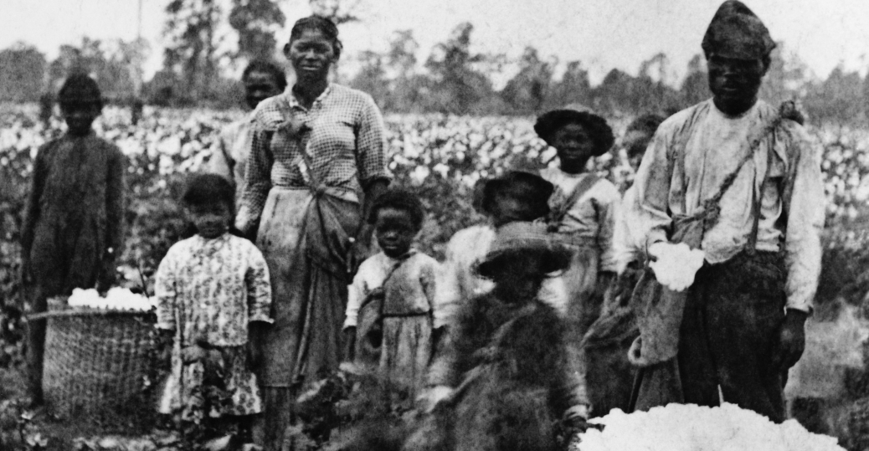
Resistance #1: FORMING FAMILIES
1) Nuclear families-
-What is 1 of 1st things we see after The Civil War & Emancipation?
-Why does 1794 cotton gin change families?
2) Leads to importance of….”larger community family”

Slide 3
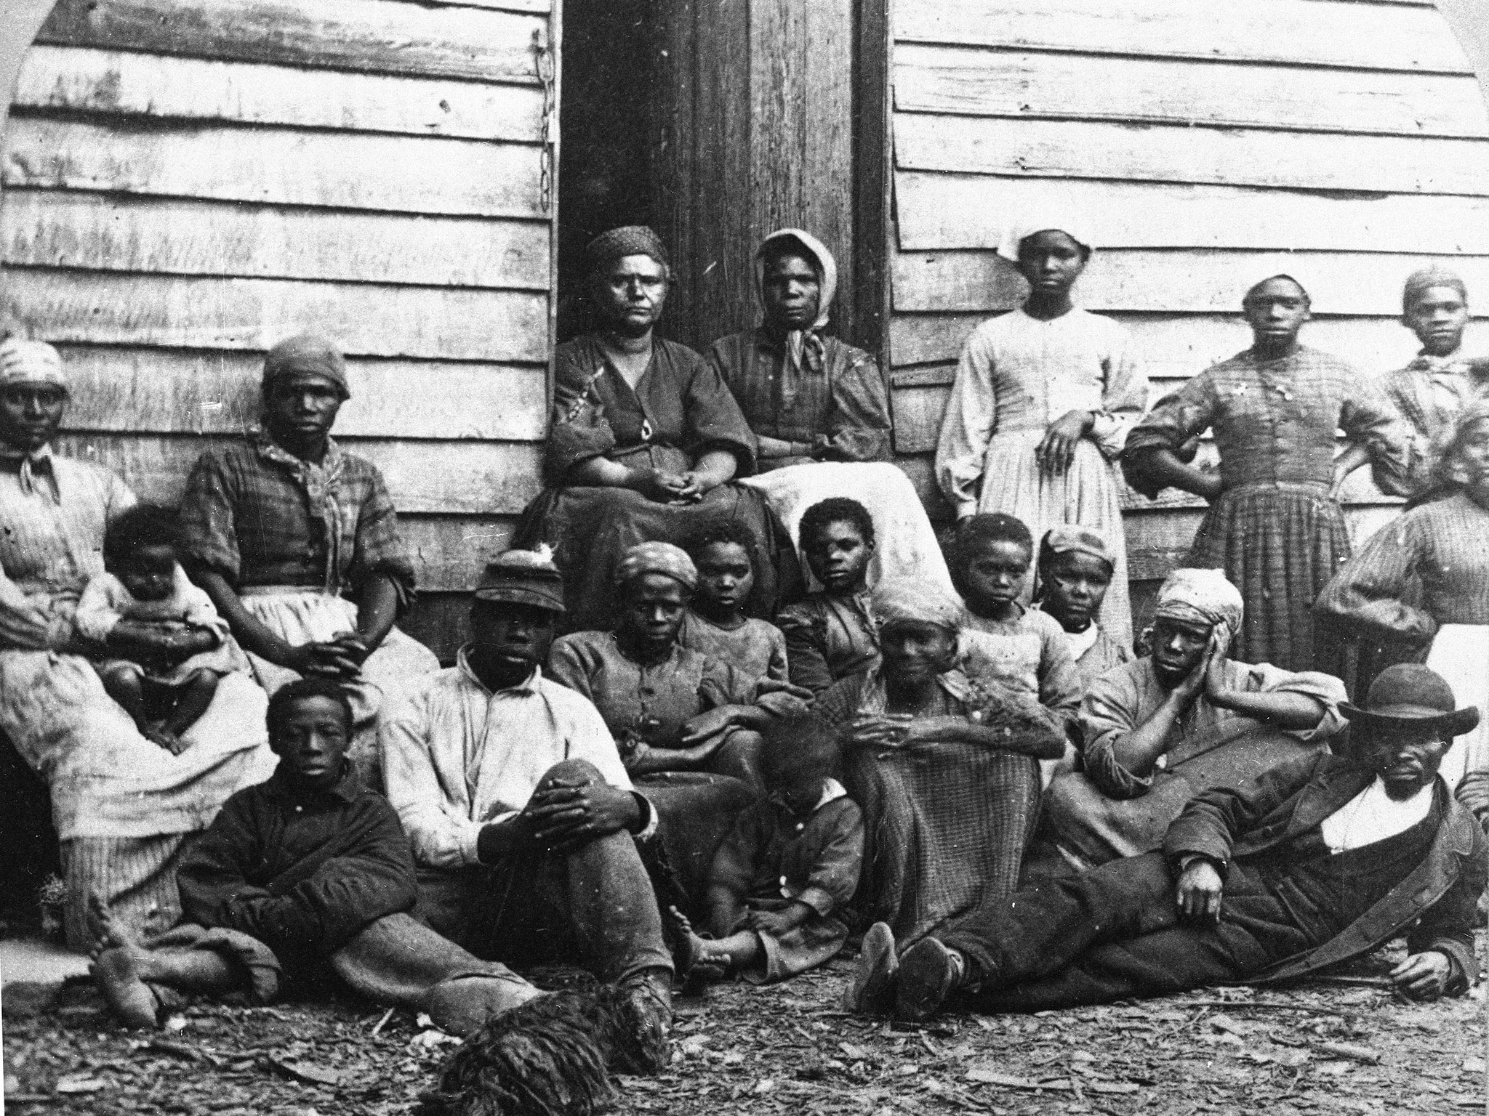
Resistance #2: Forming a Larger “AFRICAN-American” Family
-respect elders and call all elders “Uncles” and ‘Aunts”
Call your peers “brothers” and “sisters”
Is this “White/European” culture?
No it is……?

Slide 4
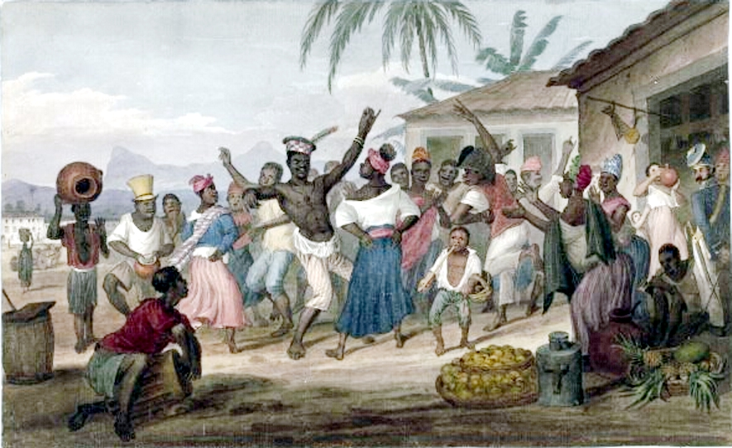
Resistance #3: Preservation of AFRICAN Cultural Identity
-Community Family
Music Dance
Oral History Food & Fashion, etc…
What is another great EXAMPLE of this…..?

Slide 5
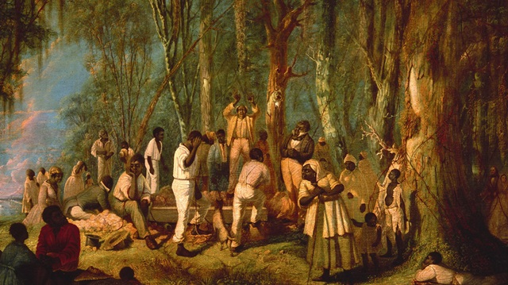
Resistance #4: Establishing an AFRICAN-American RELIGION
How can “religion” be a “battleground”?
“Battle over How to Define & Practice Christianity?”
“Slaveowner Christianity”?
1 Priest in charge of service
Emphasize Bible passages of obey Lord & Master and practice of slavery and whipping
“African-American Christianity”
African practices of ‘call& response preaching’ and ‘group singing’
Emphasize Bible passages of MOSES and God and Jesus is one the side of the poor and oppressed!
Free African-Americans form own Churches (Baptist & Methodist)

Slide 6
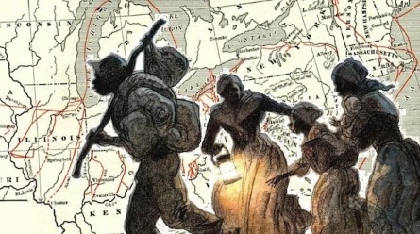
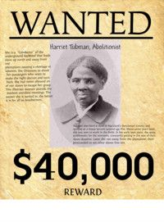
RESISTANCE #5: Running Away to Freedom
What do you know about The Underground Railroad?
Watch Powerpoint on Harriet Tubman

Slide 7
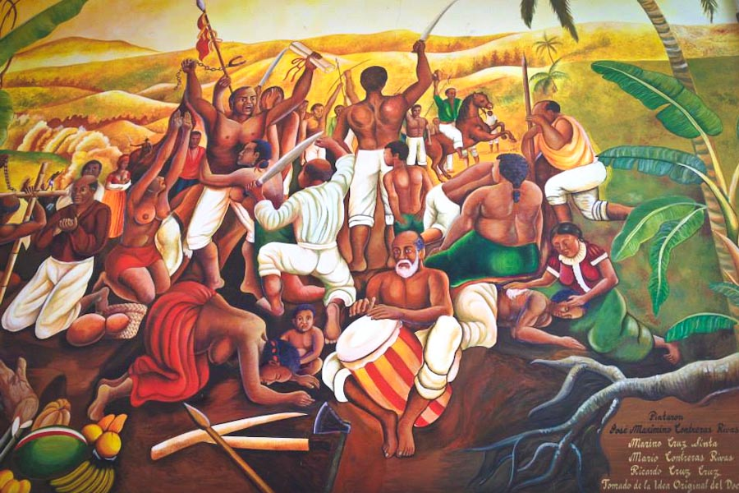
RESISTANCE #6: SLAVE VIOLENT REVOLTS
There are actually 1000s. Here are some famous ones:
1) 1800 Gabriel’s Rebellion- Gabriel Prosser in Richmond, VA
2) 1841 “Creole Case”- like the movie Amistad- a rebellion on a slave ship near New Orleans
3) 1822 Denmark Vessey Rebellion in Charleston, SC
……..the 2 most famous ones????????

Slide 8
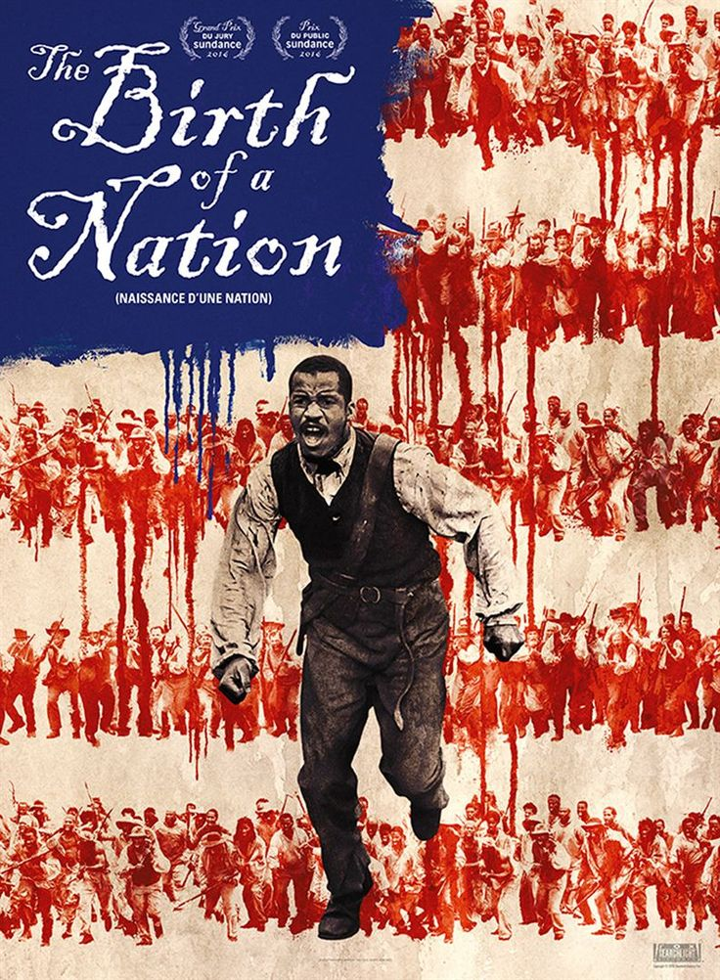
1831 NAT TURNER’S REBELLION
Nat Turner uses Religion as his Inspiration & Motivation: What is the message he says God gives to him to share?
New Movie about this rebellion called “The Birth of a Nation” (2016)
Great topic for extra credit or Project #3?

Slide 9
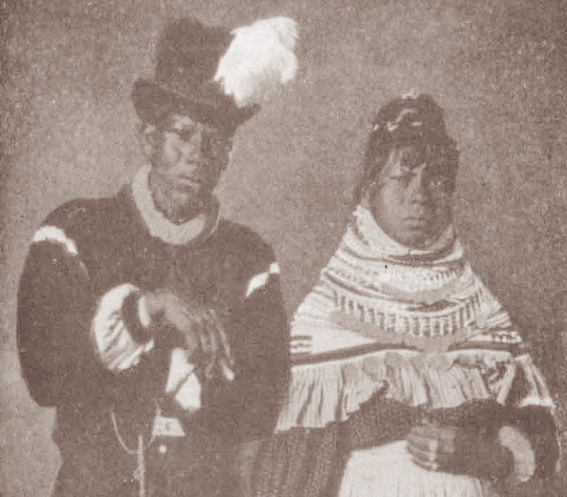
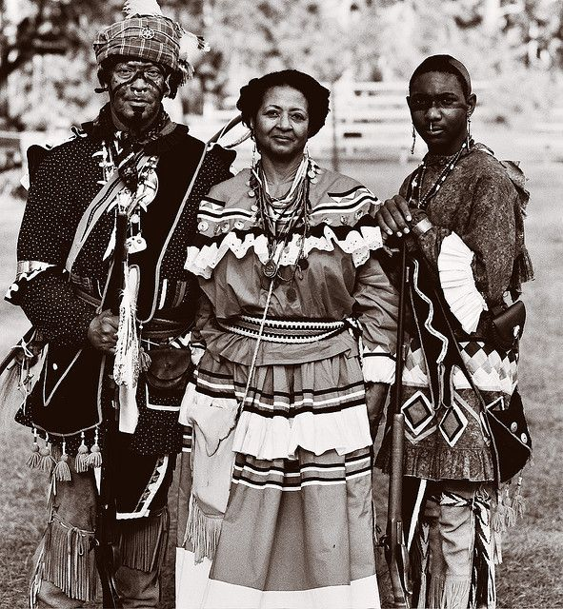
1835-38 “Black Seminole Slave Rebellion”
Many runaway slaves in the Deep South ran away where?
It turns out there are many links between African-American slaves and Native Americans
Another great topic for extra credit or Project #3?

