Slide 1
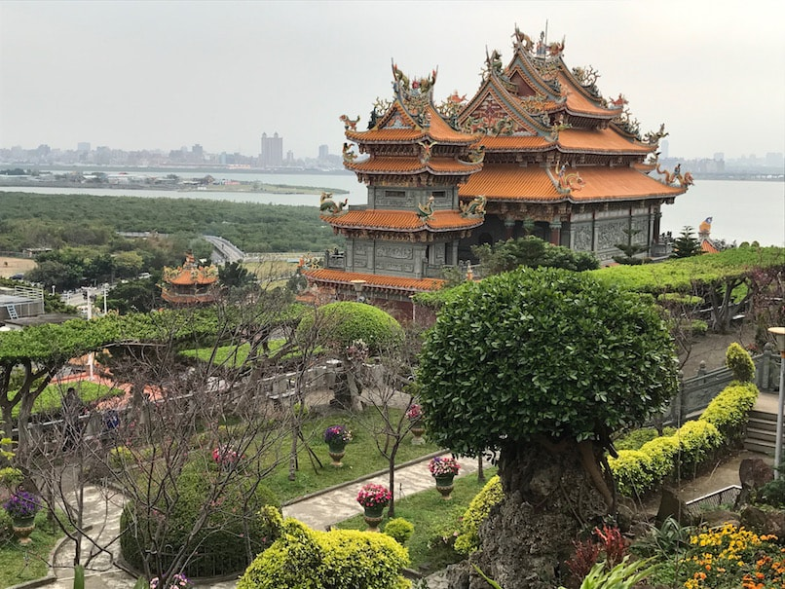
Taiwan Taoist Temples
Understanding Taoist Temples in Taiwan Part 2

Slide 2
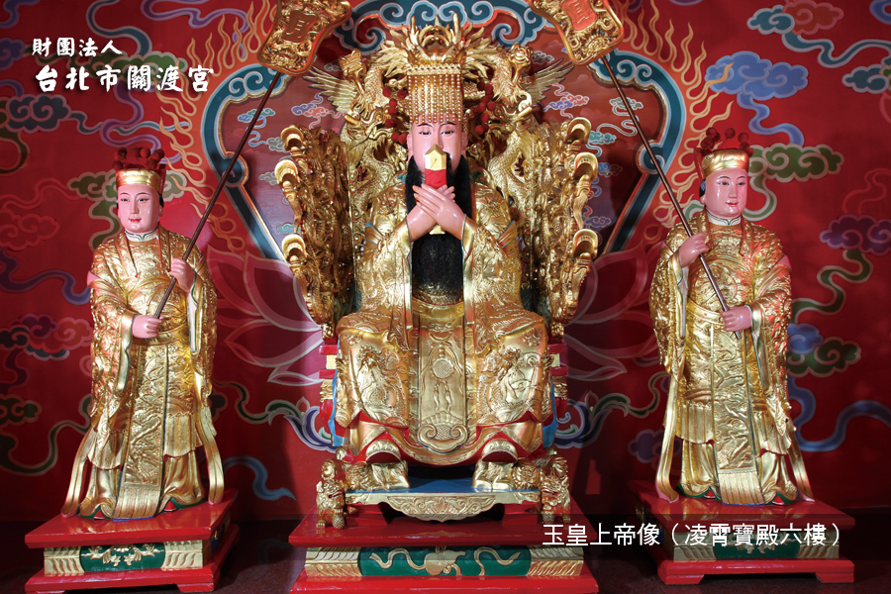
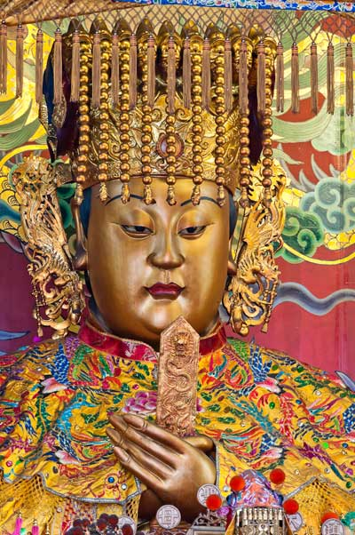
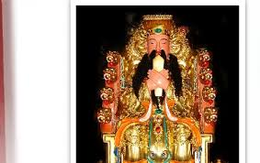
#1) ‘ALL One God’ approach
1 “Male” God above all
The Jade Emperor ‘Tiangong’
1 “Female” God above all
Queen Mother ‘Mazu’

Slide 3
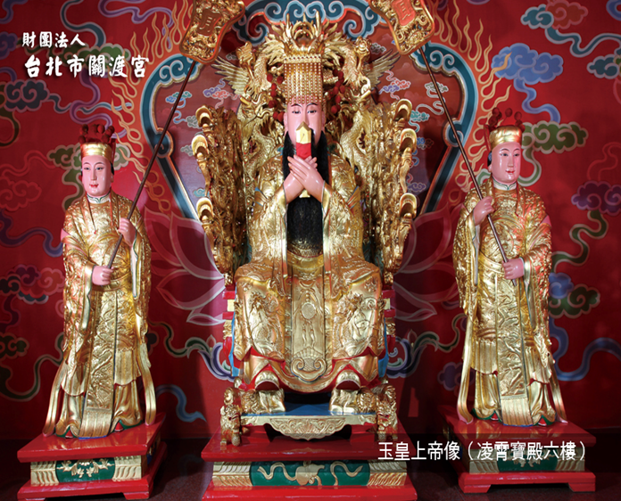
Tiangong “The Jade Emperor”
The 1 Almighty God of all
Watch this video:
https://www.youtube.com/watch?v=hQxk14MZTGo

Slide 4
Mazu (Matsu) The 1 Mother God of all
Watch this video
https://www.youtube.com/watch?v=Xdir8Mta2B8

Slide 5
#2) These are specific Taoist & local gods and goddesses approach
Gods & goddesses at this temple are ‘local gods’ who protect the community
Some were humans who became gods and like ‘bodhisattvas’ vow to protect and help humanity
Mazu legend
Watch this video
https://www.youtube.com/watch?v=apWJf_okl6s

Slide 6
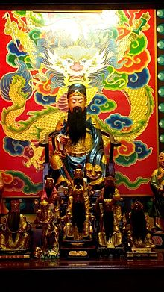
There are other ‘local’ specific gods and goddesses you can pray to…
For college acceptance, exams, & career people pray at….
Lord Wenchang Hall
Lord Wenchang & Wenkui
Watch this video:
https://www.youtube.com/watch?v=qtFIP99RQqo

Slide 7
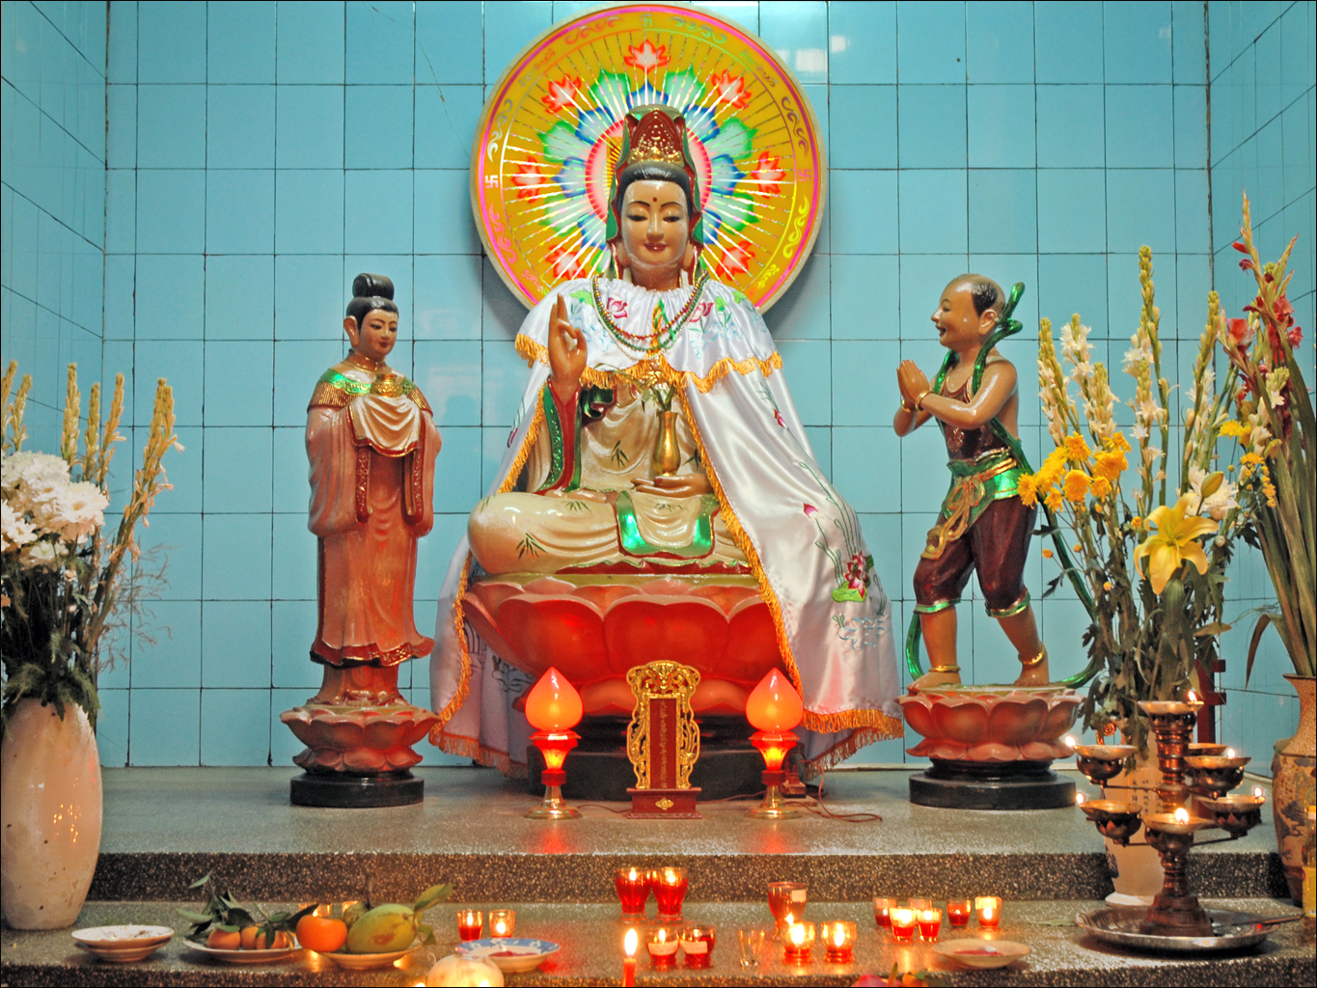
Buddhism ‘Bodhisattvas’ blend perfectly here.
Guanyin Buddha Hall
Watch this video
https://www.youtube.com/watch?v=30nqBgbSMvg

Slide 8
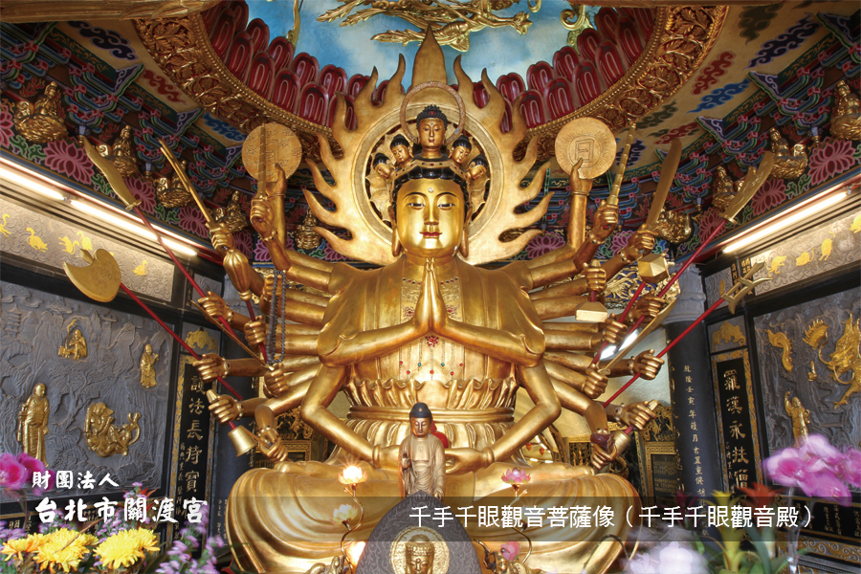
Guandu Temple has several main Buddhism bodhisattvas….
Most important is ‘1000-hands Avalokitesvara’ or “The Bodhisattva of Compassion”
Guandu Temple very special Avalokitesvara Shrine
Watch this video:
https://www.youtube.com/watch?v=6evEYrnGPsQ

Slide 9
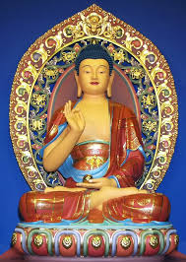
Specific bodhisattva for “Medicine Career” & Health Issues…
Bhaisajyaguru Bodhisattva
“The Medicine Buddha”
Bhaisajyaguru Hall
Watch this video:
https://www.youtube.com/watch?v=x9EhpqgfMCM

Slide 10
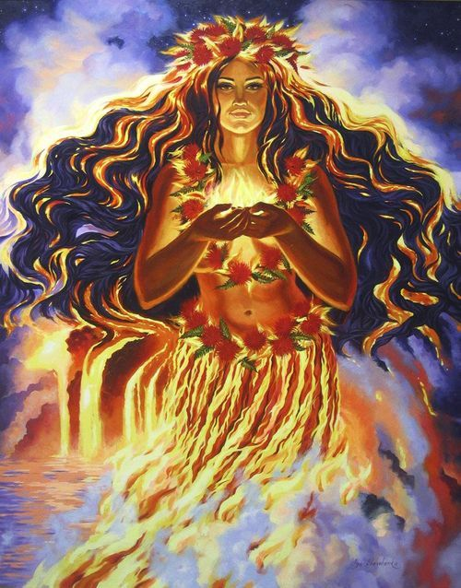
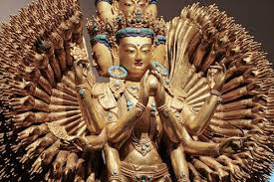
So 2 approaches to Guandu Temple so far…
You are worshipping the 1 Almighty God(dess)
Guandu Temple is special since it has a ‘Feminine Divine Almighty’ approach
You are praying for protection from
A) Local Taoist gods
B) Buddhism Bodhisattvas
(again with a ‘feminine divine spirit’)

