Slide 1
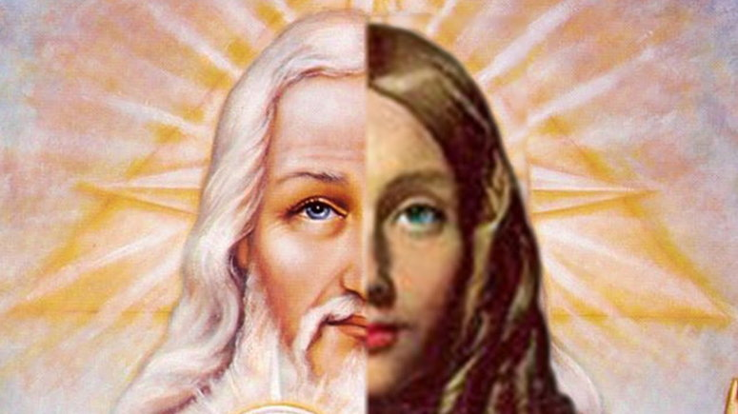
World Religions 2nd Semester
Day 1 Introduction PPT
Is God a Man or Woman?

Slide 2
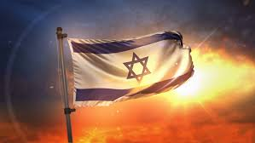
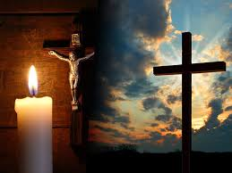
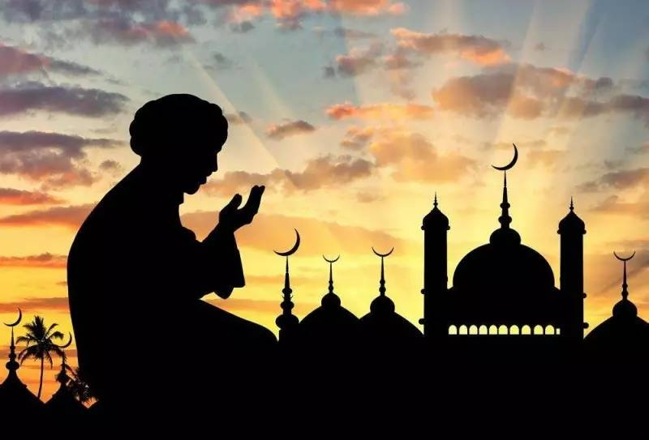
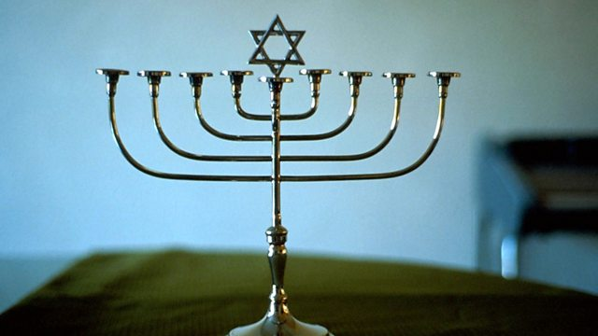
2nd Semester 3 Great Monotheistic Religions
Judaism Christianity Islam

Slide 3
How are they similar and different?
What beliefs & practices do they AGREE on?
What beliefs & practices do they DISAGREE on?

Slide 4
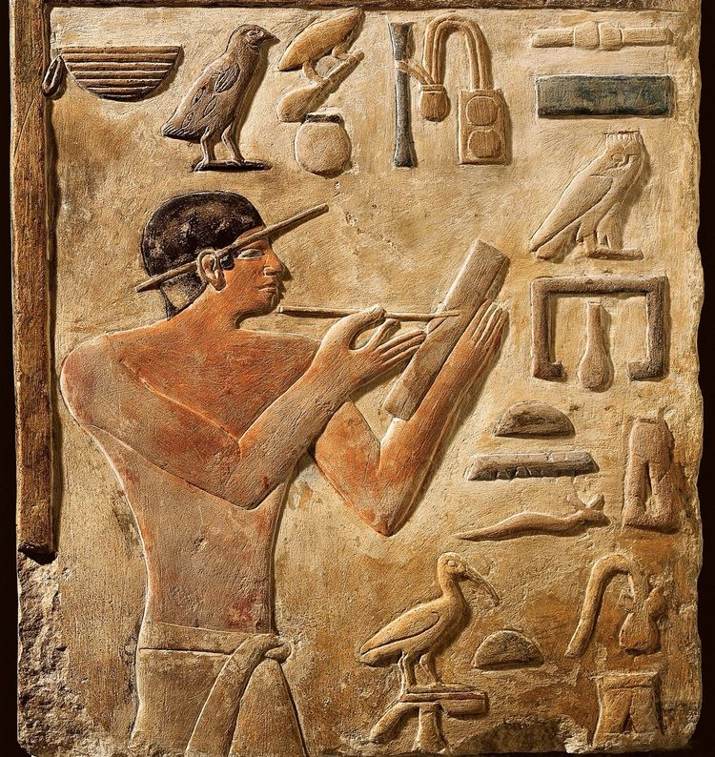
WHEN were first books of “The Bible” written? WHY maybe important to know?

Slide 5
From 2,000,000 BCE to 3,000 BCE Humans lived How?

Slide 6
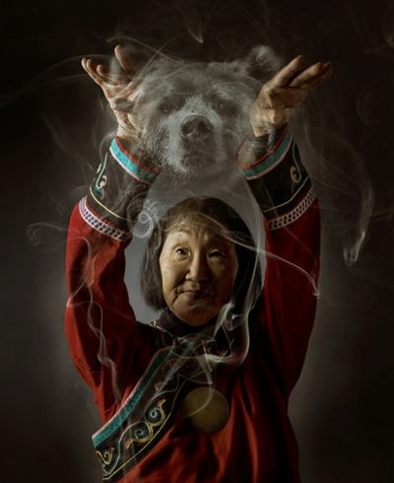
For these 2,000,000 years most humans viewed “God”how? Significance?

Slide 7
Ariana Grande ‘God is a Woman”

Slide 8
Compare & Contrast & Discuss
Ariana Grande “God is a Woman”
Michaelangelo “Adam & God”

Slide 9
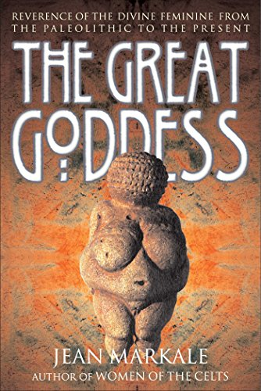
5 Big Questions/Themes to Explore
1. Is there evidence of a “GREAT GODDESS” religion 2,000,000 BCE- 3,000BCE?

Slide 10
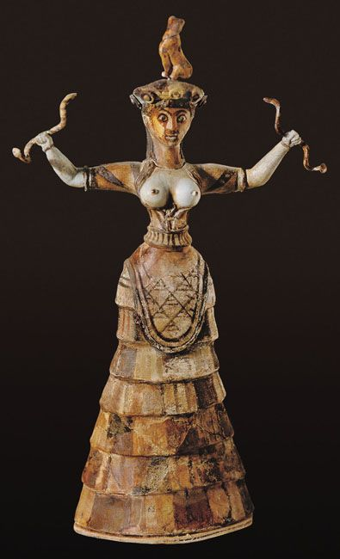
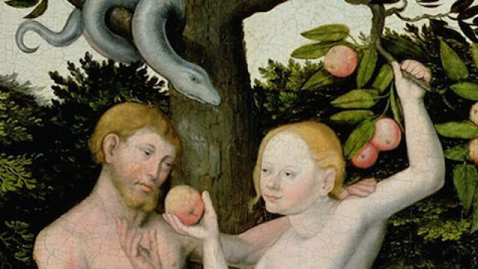
2. What’s the relationship between the FALL of the Goddess & Rise of Patriarchal 3 Monotheisms?

Slide 11
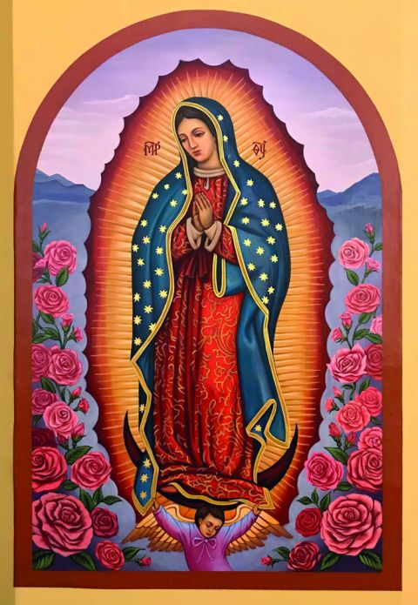
3. How has “The Goddess” tried to “survive” hidden in these 3 Monotheisms ever since?

Slide 12
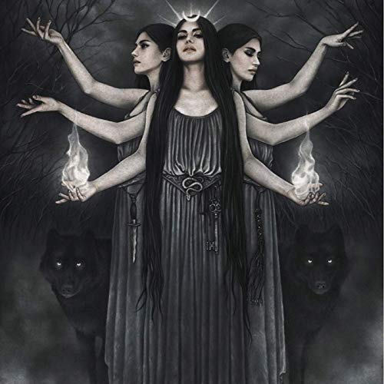
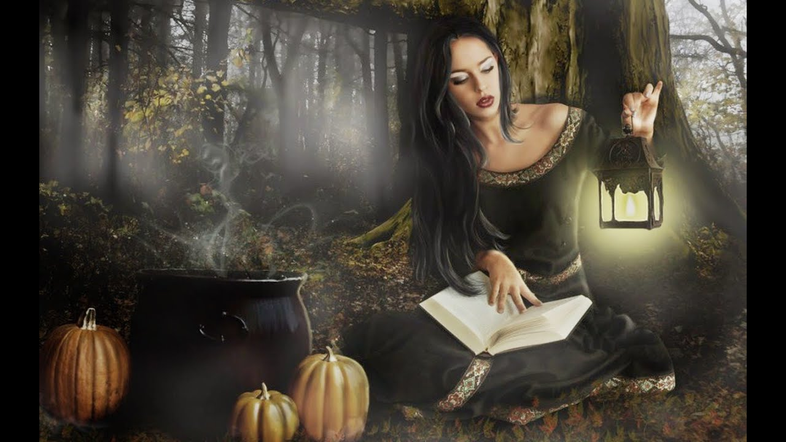
4. Is there a RISE again in the Goddess?

Slide 13
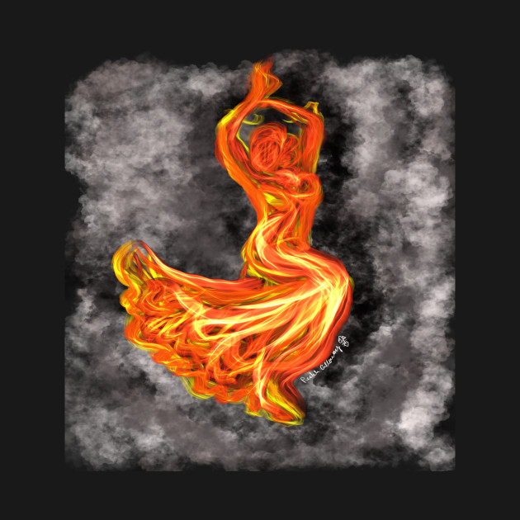
5. How can all this help GIRLS & WOMEN(and boys and men too!) today approach RELIGION & SPIRITUALITY?

