Slide 1
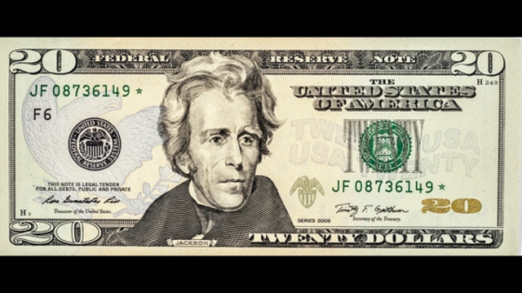
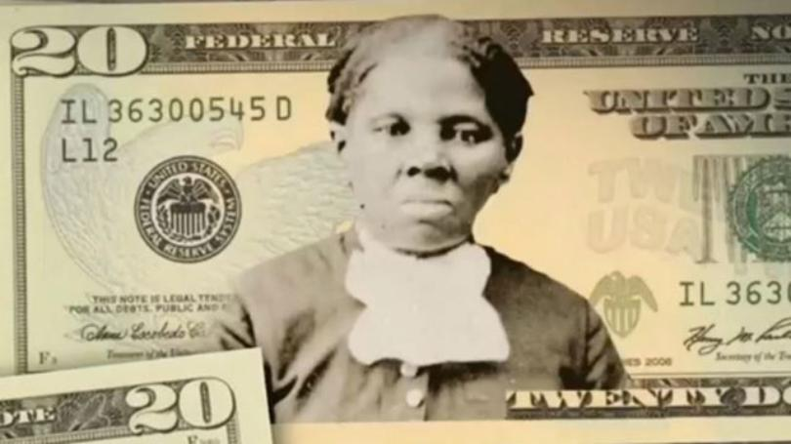
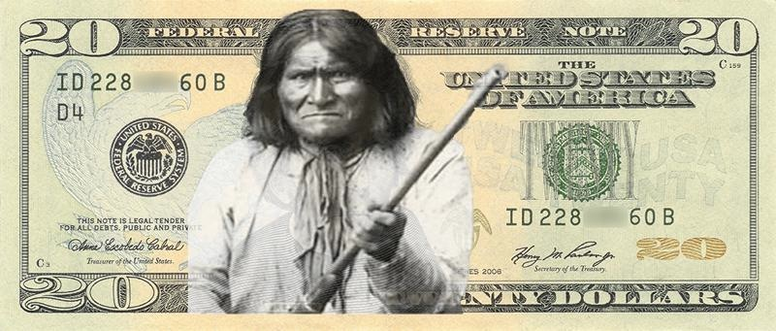
Andrew Jackson Debate

Slide 2
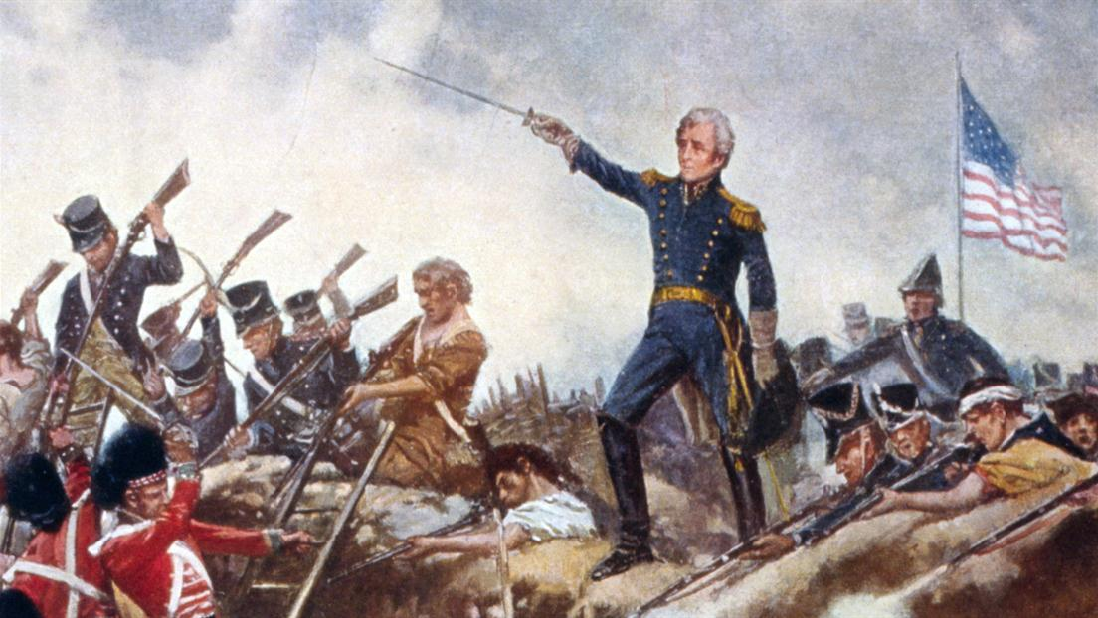
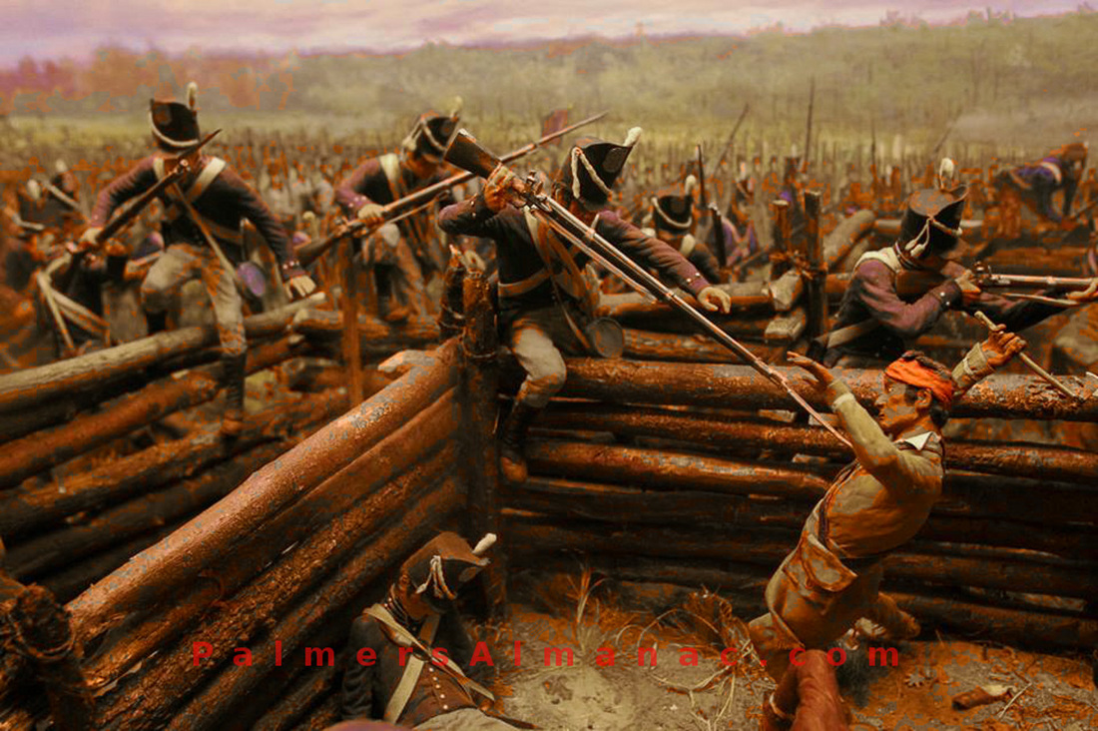
War of 1812
PROS…
Helped USA win the War
Battle of Horseshoe Bend 1814
Battle of New Orleans 1815
CONS…
Jackson actual nickname was ‘Indian-Killer”
Killed 1000s of Creeks during the War

Slide 3
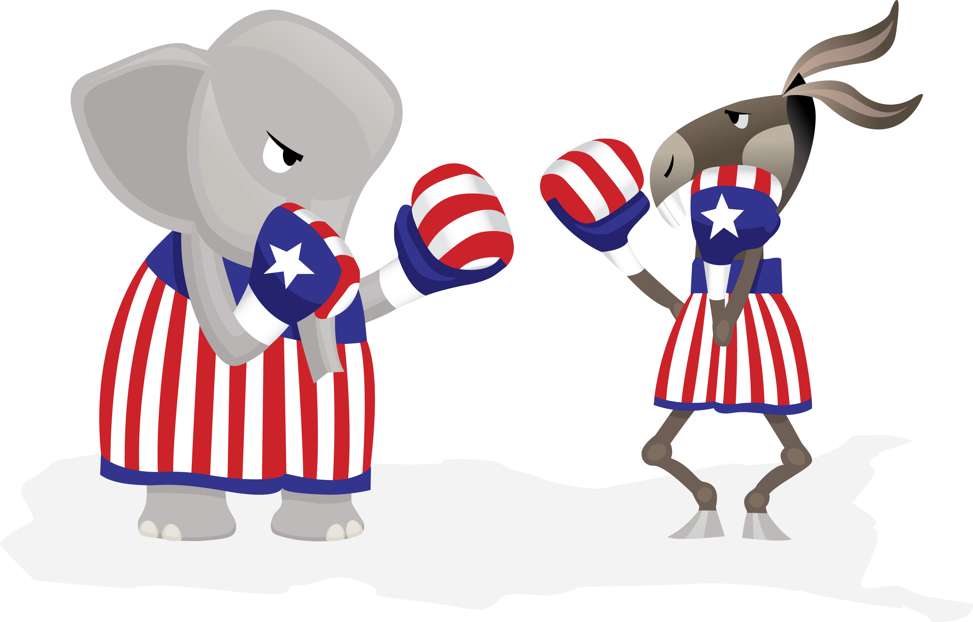
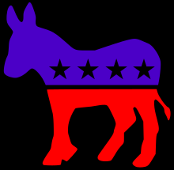
1824 Forms Democratic-Republican Party
After losing to President John Quincy Adams
Forms new “Democratic-Republican Party”
This is the historical birth/start of the modern “Democratic Party”
The start of “opposition politics”
Its mission is to fight and defeat anything President JQ Adams tries to do in government.

Slide 4
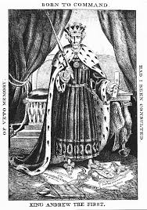
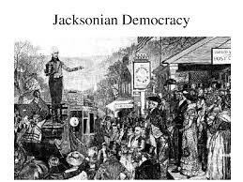
Election of 1828
PROS…
Some say 1st “democratic”/”people-decide” President election
States changed voting requirements for more common men to vote
Jackson victory was “victory of common man”
Jackson son of poor immigrants
CONS…
Actually by 1828 Jackson just “pretended to be a common man”
Jackson is actually a millionaire Southern slaveowner
Jackson wins because he just “tells common people what they want to hear”

Slide 5
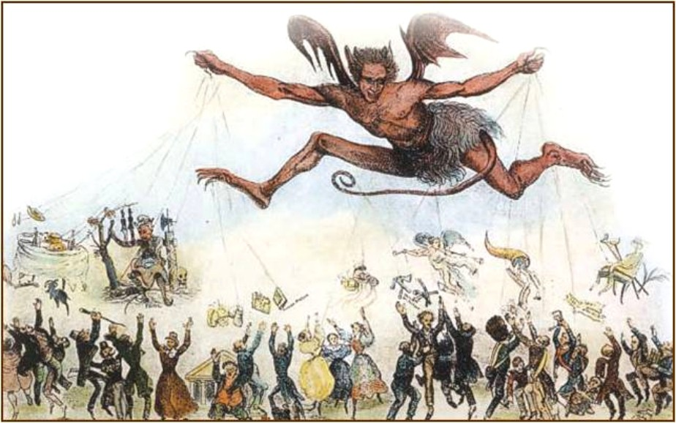
Jackson changes USA Federal Government
PROS
“Drain the Swamp”
4 year max terms for federal government officials
Removes many government officials
CONS
He fills swamp with “spoils system”
Patronage politics- fill government positions with your friends

Slide 6
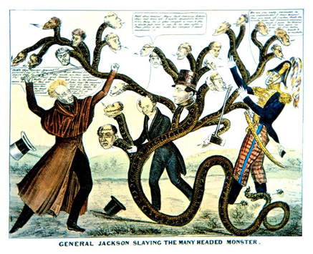
Jackson and Banks
Jackson wants to remove big money from US Gov’t
“Kills the Bank of the United States”
Leads to The Panic of 1837
Jackson “pet banks” smaller but just as “corrupt”- but now with no federal control on them
“Pet banks” print all the money they want not tied to gold standard
Paper money becomes useless- only super rich can buy stuff with real gold

Slide 7
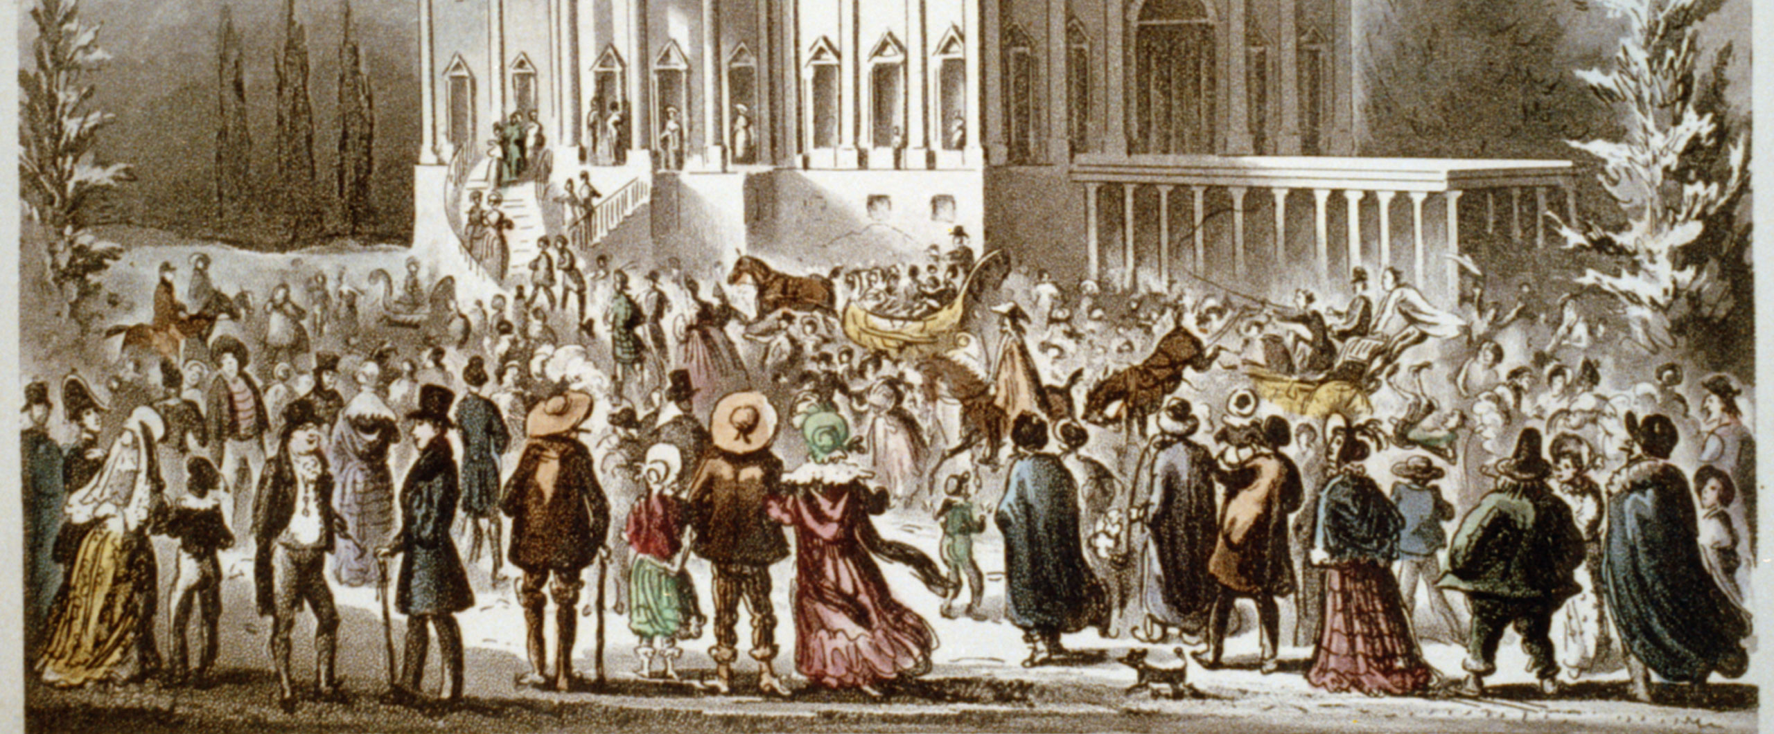
Jackson changes USA Politics
PROS…
“Democratization”
Must appeal to the “common man” to get elected to US Gov’t
CONS…
Does US Politics become a “Reality Show” but not true “reality”?
1840 President Election
Democrats- Pres. Martin Van Buren “portrayed” as aristocrat but actually not
Whigs- Pres. Wm. Henry Harrison “portrayed” as common man & tough “Indian killer”
“Tippecanoe & Tyler too!”

Slide 8
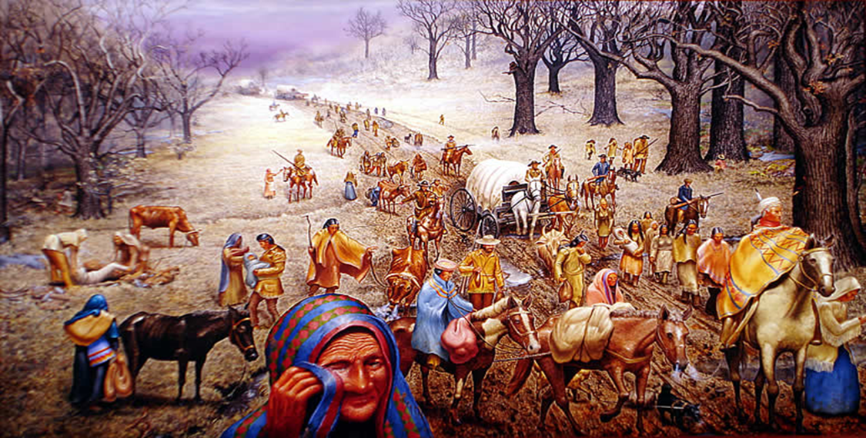
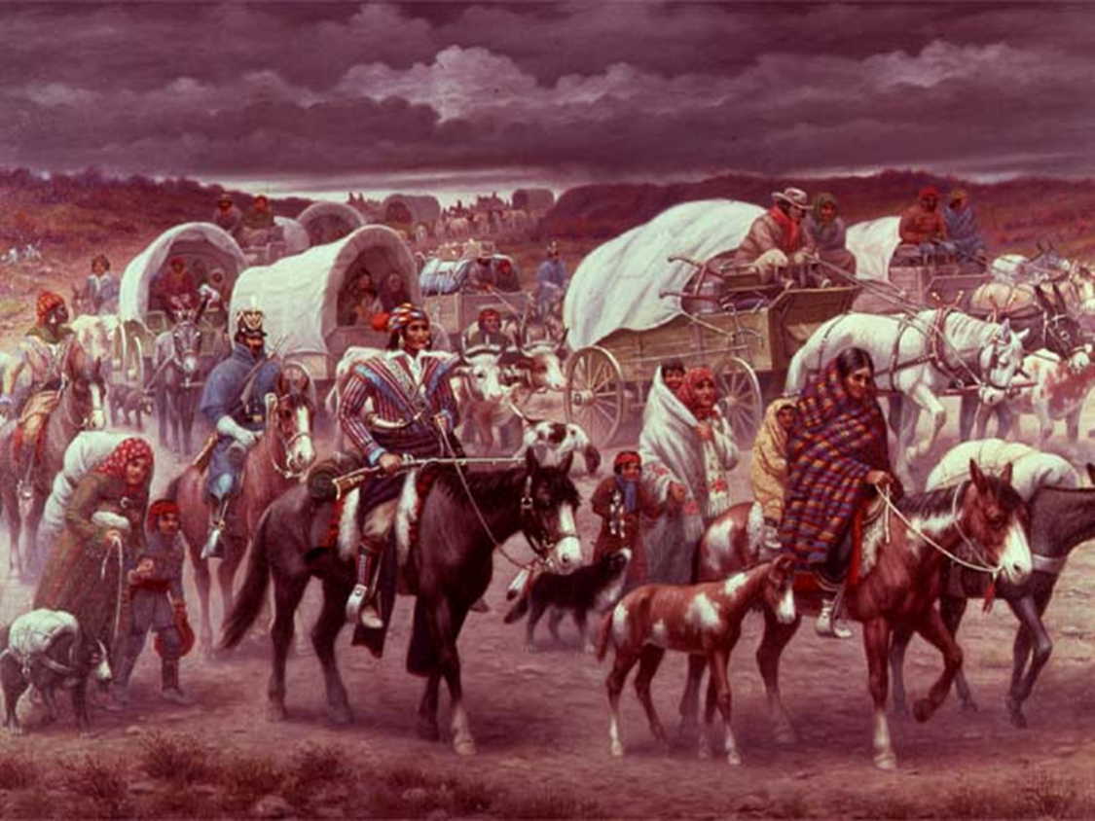
Jackson & Native Americans Page 228
POINT
“Trail of Tears”
COUNTERPOINT
1830 Indian Removal Act

