Slide 1
Sarah Winnemucca
Olivia Liang

Slide 2
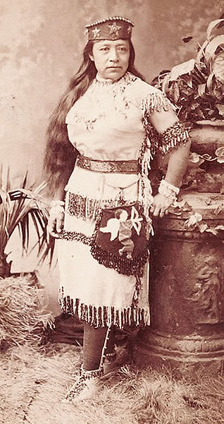
Background
Northern Paiute author, activist and educator
borned in 1844 near Humboldt Lake, Nevada
influential Paiute family
led their community in pursuing friendly relations with the arriving groups of Anglo-American settlers
studied in a Catholic school in Santa Clara, California
escaped to San Francisco and Virginia city to escape the Paiute War between the Pyramid Lake Paiute and the settlers
made a living performing onstage as "A Paiute Royal Family"
band attacked by US cavalry in 1865
killed 29 Pautes, including Sarah's mother and several members of her extended family.

Slide 3
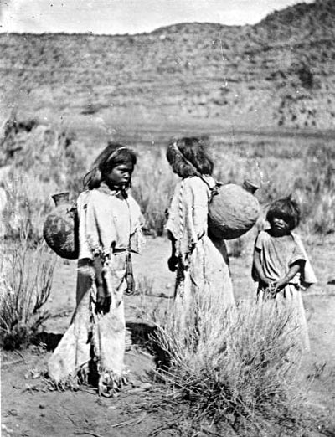
Paiute
Lived in southern Utah and parts of California, Arizona, and Nevada for a thousand years
Lived in cone-shaped wickiups (especially in winter) or in the open air.
Traveled and lived in small family groups of 15-30
food
used at least 96 species of plants.
Used the pinyon pine nut important food
Grew corn, squash, beans, sunflowers, wheat, melons.
caught fish and small animals
Prayed to influence the spirits of nature and to show respect and gratitud
called the most powerful spirit being “The One Who Made the Earth.”
Mormons
convert faith
hired them to farm, agricultural knowledge
diseases
take over land
Today the tribe owns 4,470 acres scattered throughout southwestern Utah.

Slide 4
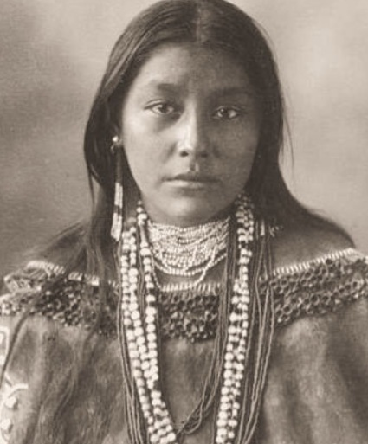
Activism
avocate for rights of Native Americna
traveling across the US to tell Anglo-Americans about the plight of her people
When the Paiute were interned in a concentration camp at Yakima, Washington after the Bannock War, she traveled to Washington, D.C. to lobby Congress and the executive branch for their release
She also served US forces as a messenger, interpreter, and guide, and as a teacher for imprisoned Native Americans.

Slide 5
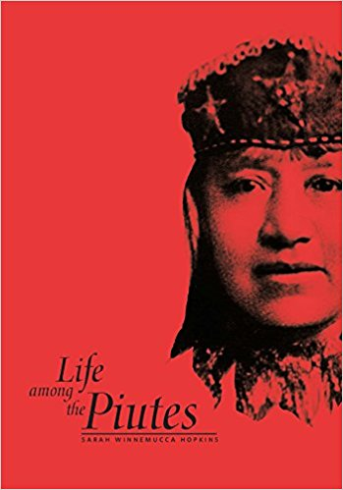
Publication and Writing
published Life Among the Paiutes: Their Wrongs and Claims (1883)
both a memoir and history of her people during their first 40 years of contact with European Americans.
first known autobiography written by a Native American woman."
Anthropologist Omer Stewart described it as "one of the first and one of the most enduring ethnohistorical books written by an American Indian,"
Following the publication of the book, Winnemucca toured the Eastern United States, giving lectures about her people in New England, Pennsylvania, and Washington, D.C.
She returned to the West, founding a private school for Native American children in Lovelock, Nevada.

Slide 6
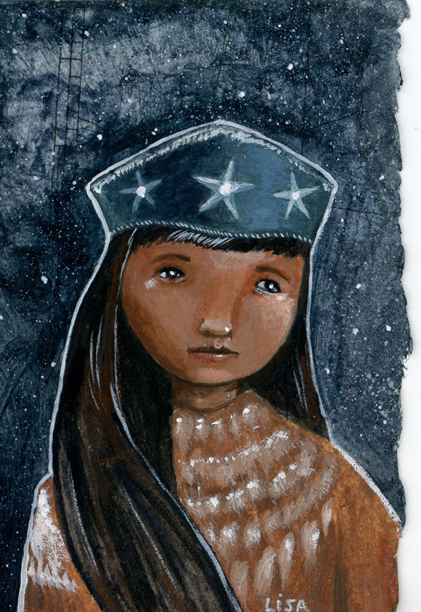
Conclusion
controversial
from biographer
positive: activism and social work to better the conditions of her people
criticisms: her tendency to exaggerate her social status among the Paiute
from Paiute
positive: her social work and activism for indigenous rights
critisims: her advocacy for assimilation of Natives to Anglo-American culture

