Slide 1
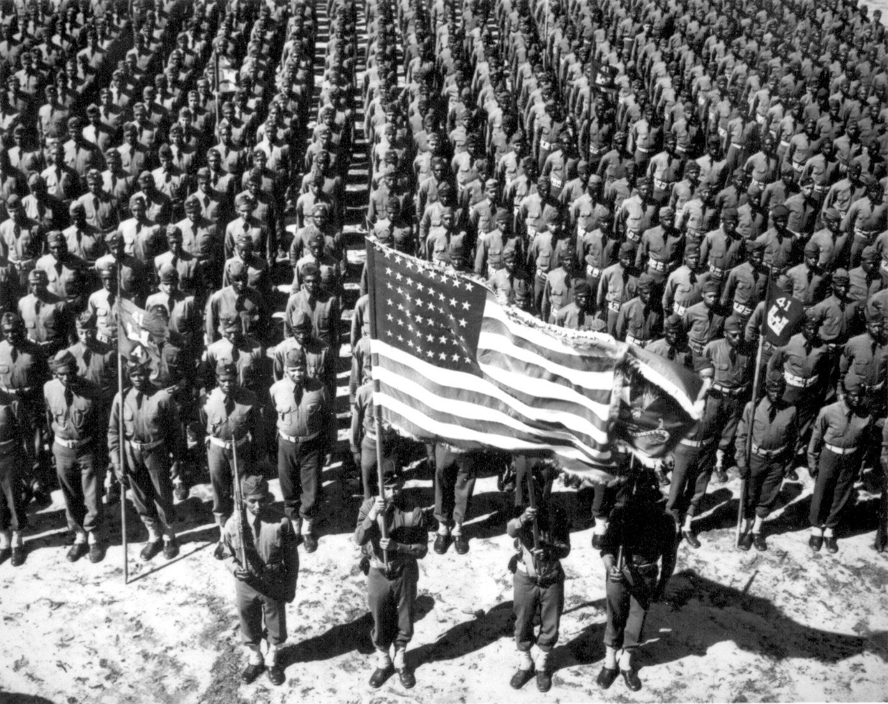
World War I and the USA

Slide 2
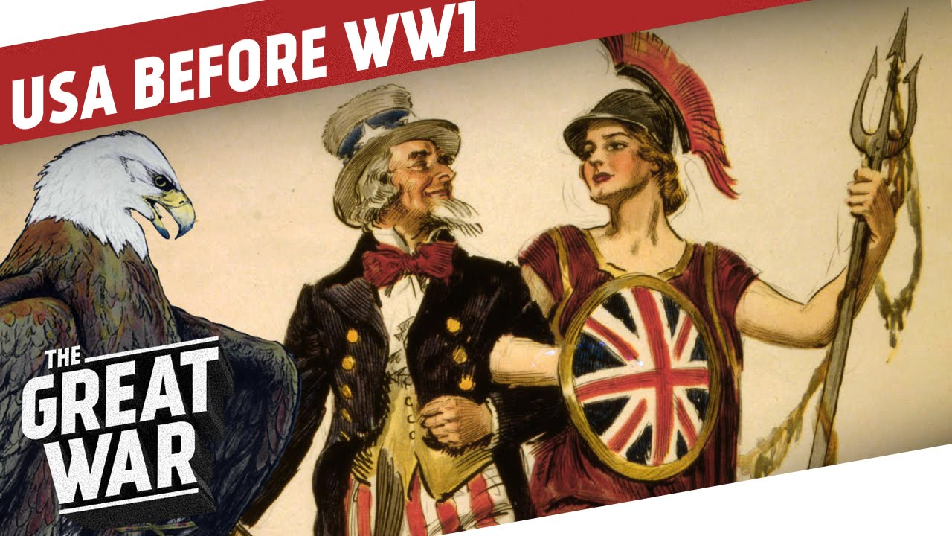
Discuss with Team: Main ideas in your homework: What were the positive and negative effects of World War I on the United States?

Slide 3
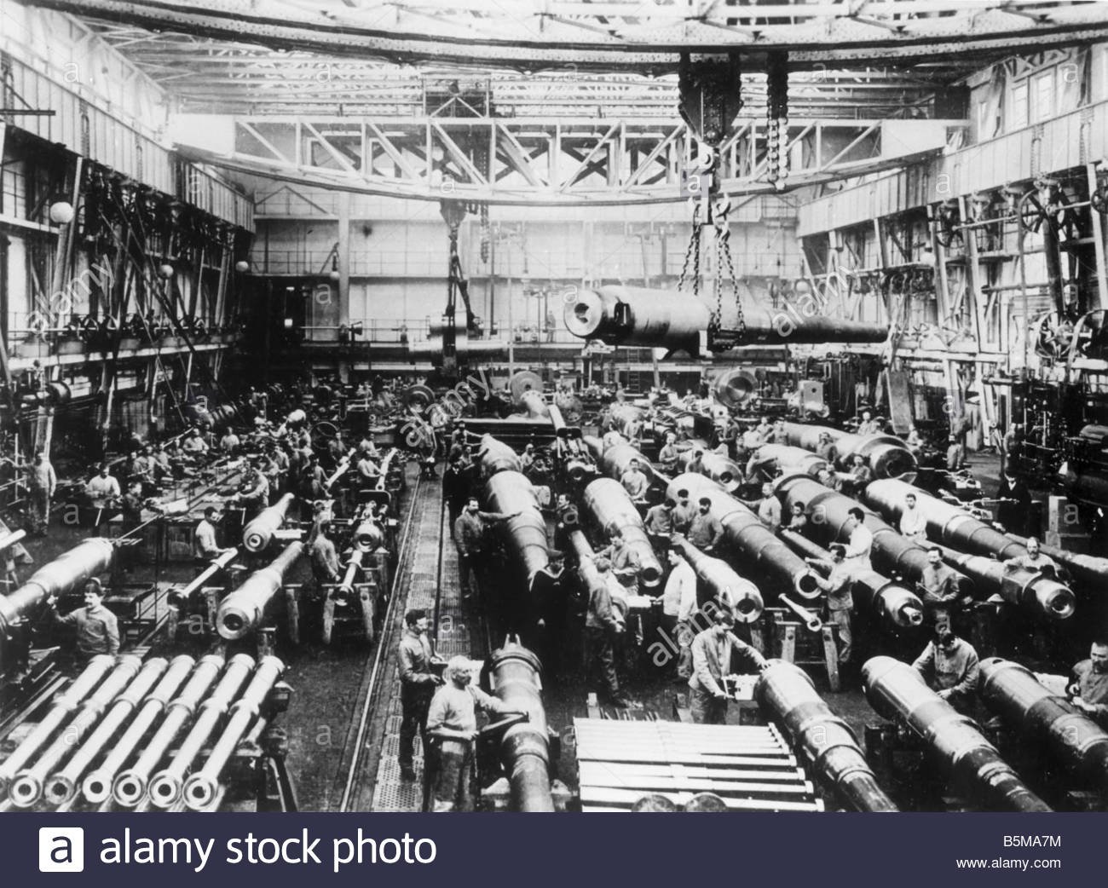
USA Economy becomes world’s only #1 superpower during WWI 1914-1917
POSITIVE
Booming economy
NEGATIVE
Economy tied to “war”?

Slide 4
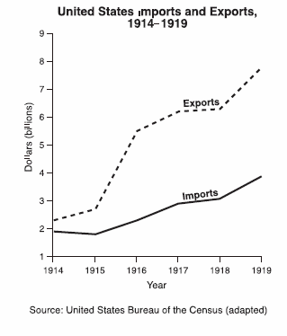
USA Economy will “boom” after World War 1 (1914-1929)
POSITIVE-SIDE
Text Page 595
Avg. income rises
1914 $627/year
1920 $1407/year
BUT….(Negative-side?)
Who really benefits from “boom”?
Top 1% shareholders
Dupont making $68 million/year profit
Average American no big increase in standard of living? Why?
INFLATION? Pg 595 ‘Consumer Price Index’?

Slide 5
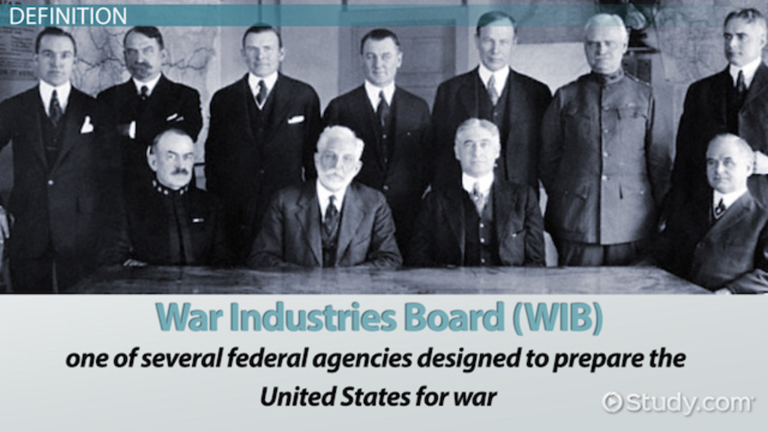
USA Economy becomes a ‘command economy’- very proficient
POSITIVE
WIB (War Industries Board) ensures 100% US economy working together to support war effort
NEGATIVE?
Is this ‘fascism’ and not ‘free-market?”
100% US economy is for war

Slide 6
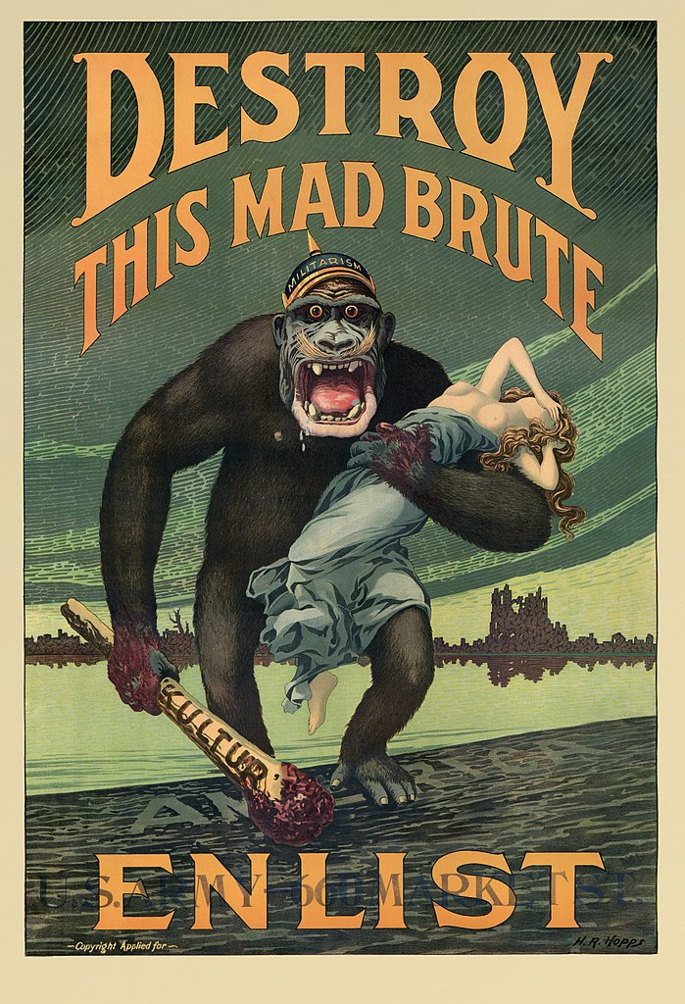
US Government greatly increases size and power
POSITIVE
Majority of Americans support war effort and success of WWI
NEGATIVE
Fascism elements?
Propaganda
CPI
Committee on Public Information
1917 Espionage & Sedition Acts

Slide 7
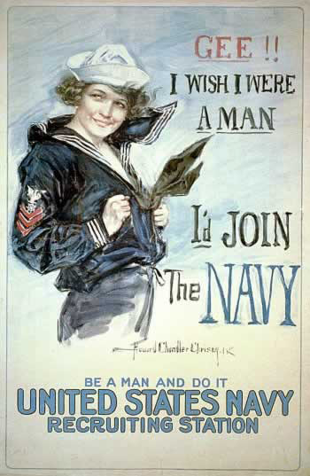
CPI- Committee on Public Information
US Government propaganda to make Americans support WWI
-Anti-German immigrant hysteria

Slide 8
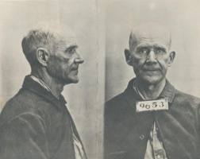
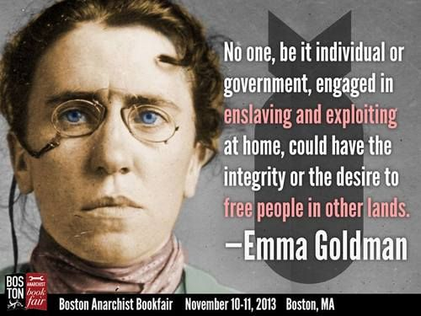
1917 Espionage & Sedition Acts Illegal to criticize US government or World War I effort
Eugene Debs
“Wars are started by and for only the rich & fought only by the poor”
10 year prison sentence for this sentence
Emma Goldman
No Conscription League
Free countries should not force its citizens to join army and kill others
2 years in jail/ $10,000 fine
DEBATE WITH YOUR TEAM…..
Is this good or bad?

Slide 9
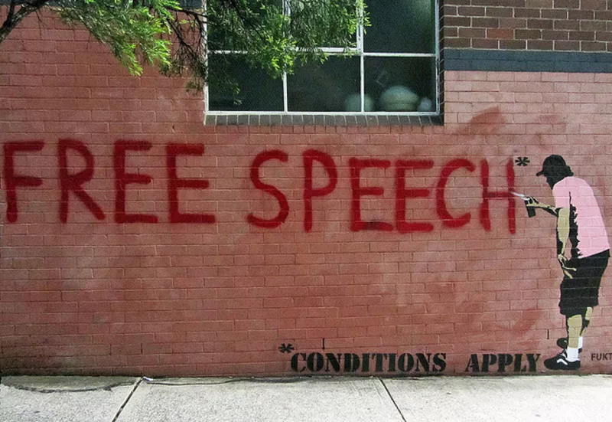
Pg 602 Schenck vs. United States 1919 Debate with your team
1917 Ruling
First Amendment Freedom on Free Speech and Protest can have limits if “clear and present danger” such as “yelling fire in a crowded theatre”.
War-time is the same situation, so free-speech can be limited
Agree or disagree and why?
1919 Ruling
More pro-free speech because “truth will win out in a free and open marketplace of ideas.”
Agree or disagree and why?

Slide 10
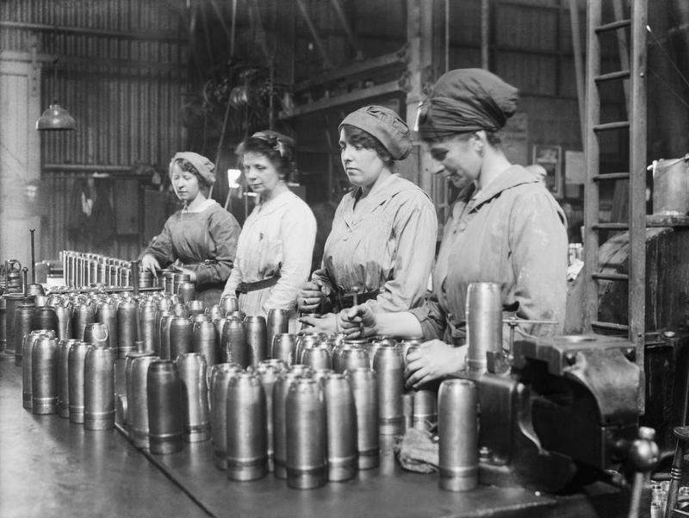
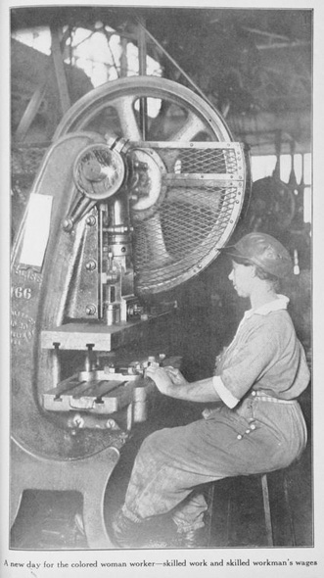
BIG SOCIAL CHANGE because of WWI- 100,000s factory jobs + 100,000 men away at war =
More jobs for …
women
More jobs for…
African-Americans

Slide 11
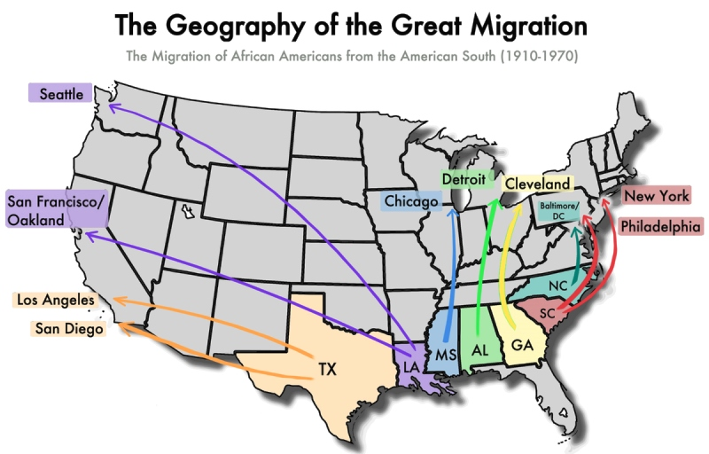
World War I effects on African-Americans
NEGATIVE
African-Americans discover almost just as much racism & prejudice in Northern cities as in the South
Race Riots
1919 Chicago Race Riot
Great research topic- ‘Arc of Justice’
POSITIVE
Increases ‘The Great Migration’ of African-Americans from Jim Crow South to cities in the North, especially New York and Chicago
Lead to Harlem Renaissance (and Jazz) in New York
Lead to rise of Blues in Chicago

Slide 12
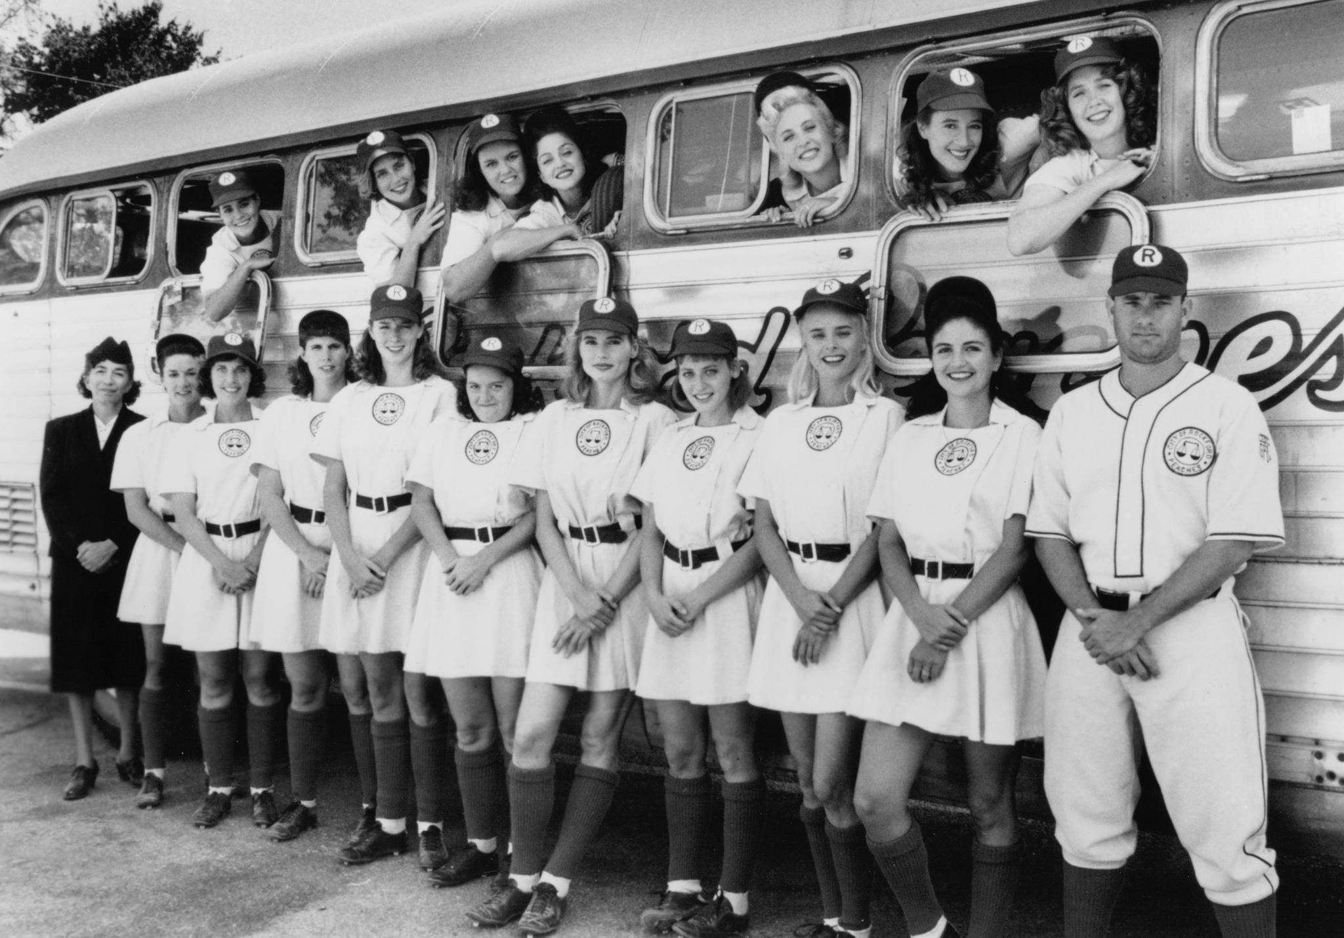
World War I Effects on Women -WWI pushes 100,000s women out of home into work-world for first time…
POSITIVE
Women enter work-force in large numbers
Greater economic power means greater social power?
1919 The 19th Amendment
Alice Paul?
NEGATIVE
What happens when men return from war?
Great research topic-
‘A League of their Own’

Slide 13
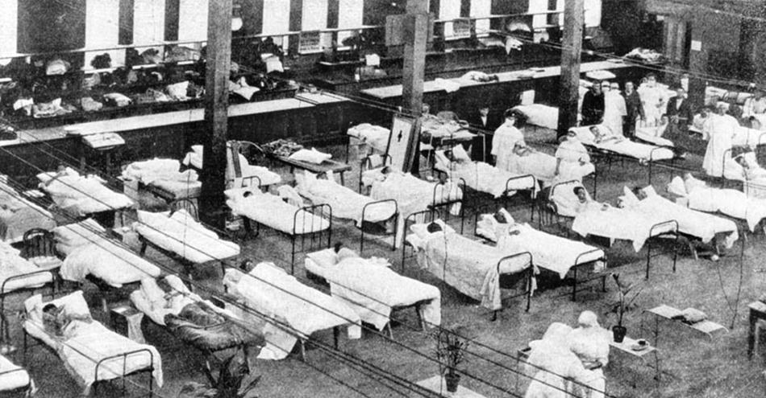
One final effect of WWI- 1919 Flu Epidemic
Overcrowding in cities
No social programs
War and bad hygiene
_____________________________
= disease spreads!
1917-1919 Flu Epidemic
500,000 Americans killed
30,000,000 people worldwide killed
Great research topics…

